Slide 1
WebQuiz Prototype
Green arrows indicate where you should click to continue with the prototype. If there are more than one arrows then you can click either.

Slide 2
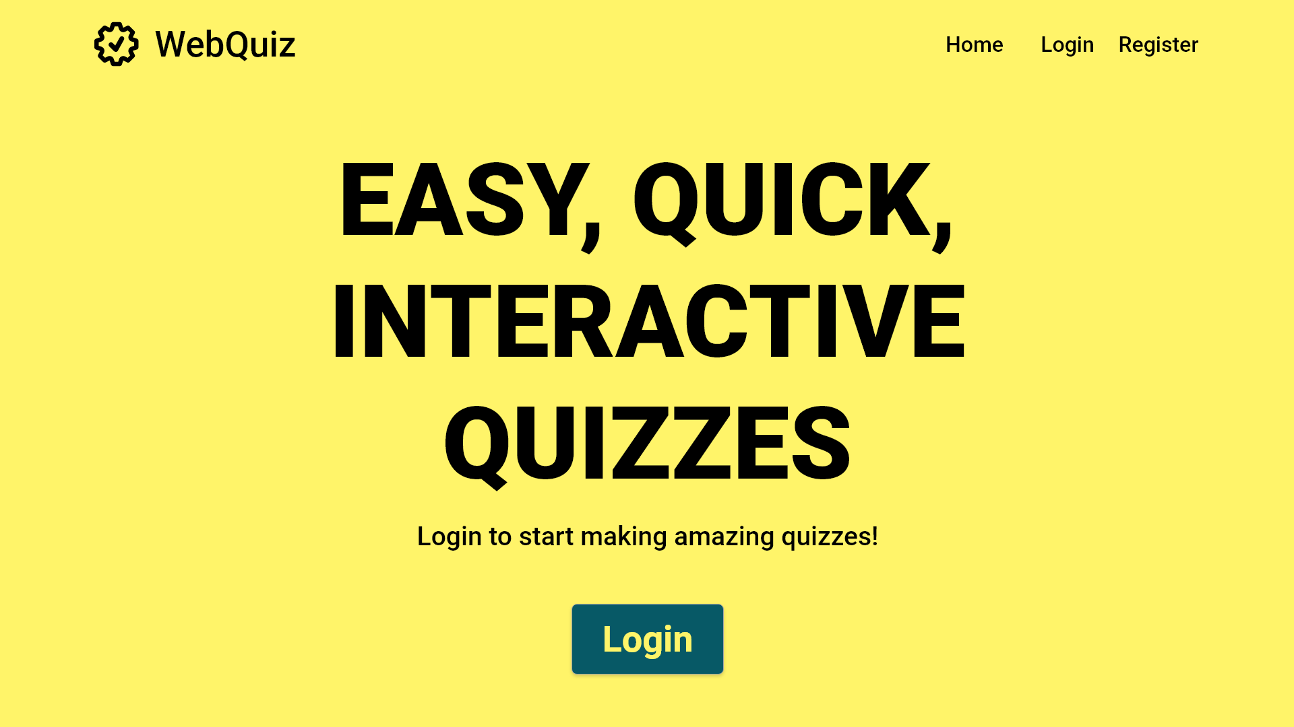
If the Quiz Maintainer does not have an account, one can be registered here

Slide 3
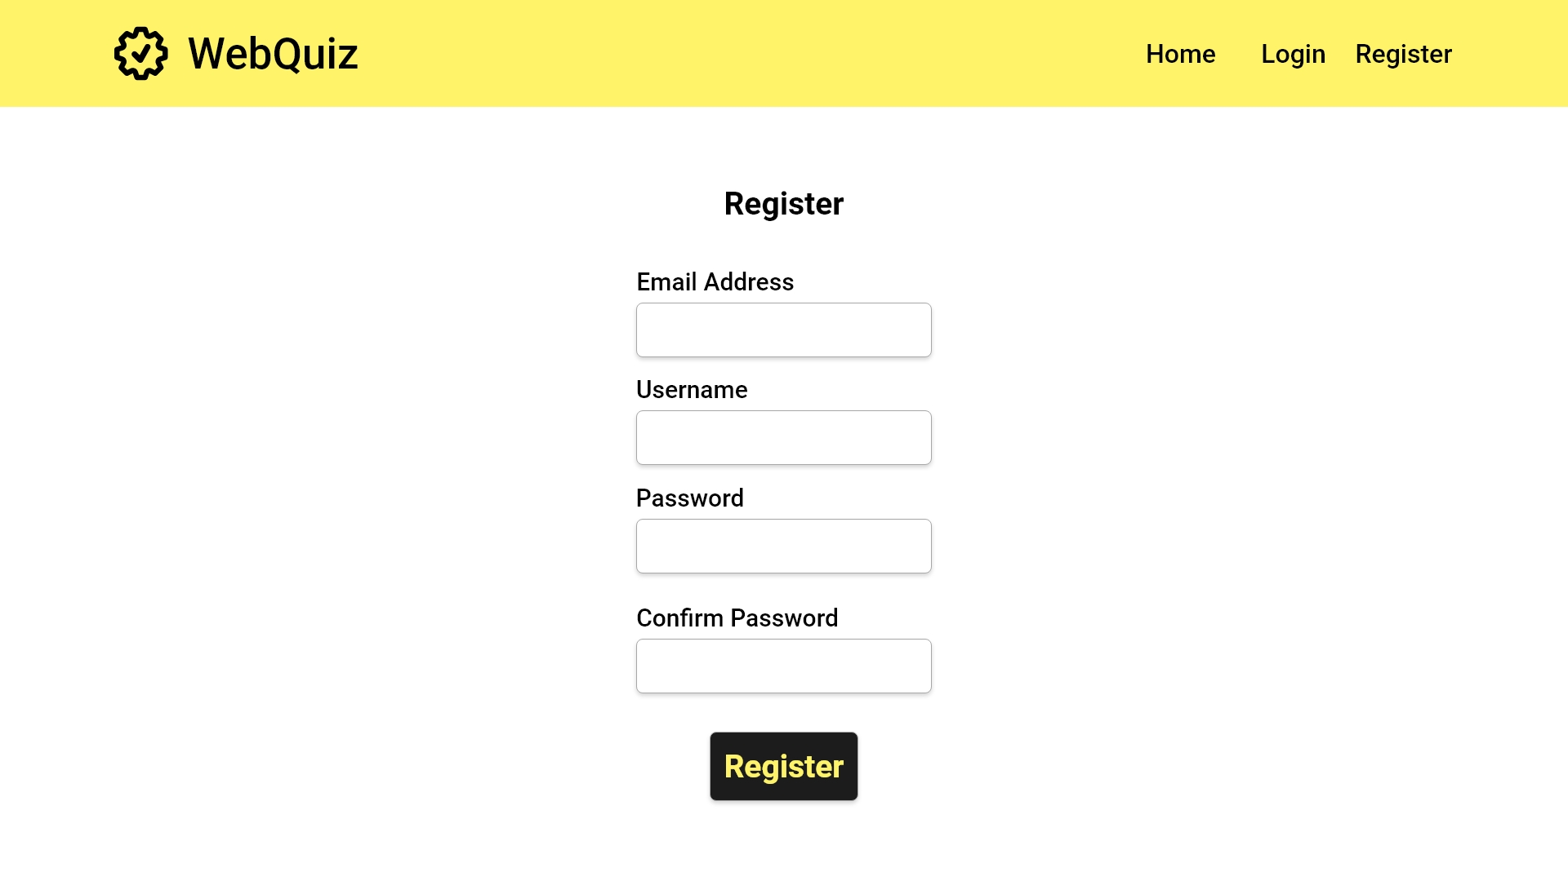
USE CASE 1.0
Quiz Maintainer account creation
Start Register
User fills in text boxes
USE CASE 2.0
Quiz Master account creation
Click the button once forms are filled
Error case

Slide 4
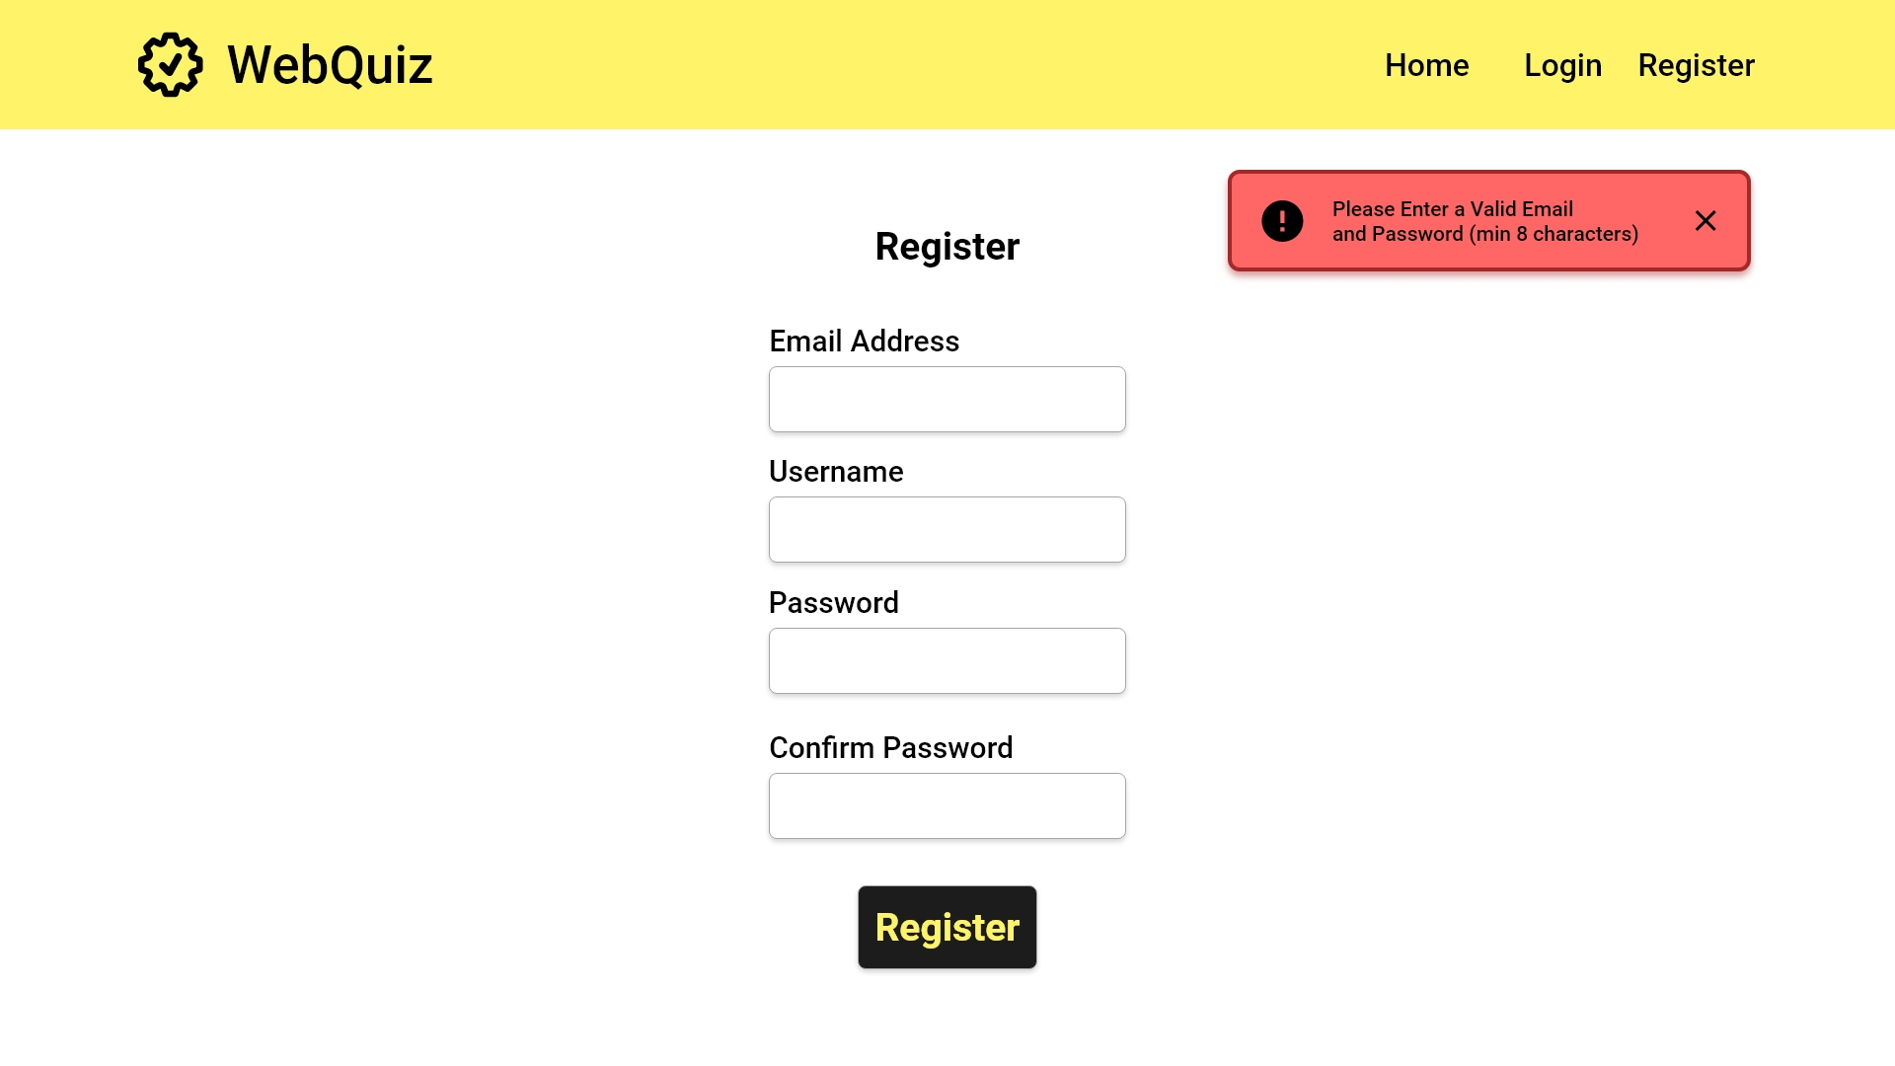
An error message will be returned if either box is left blank

Slide 5
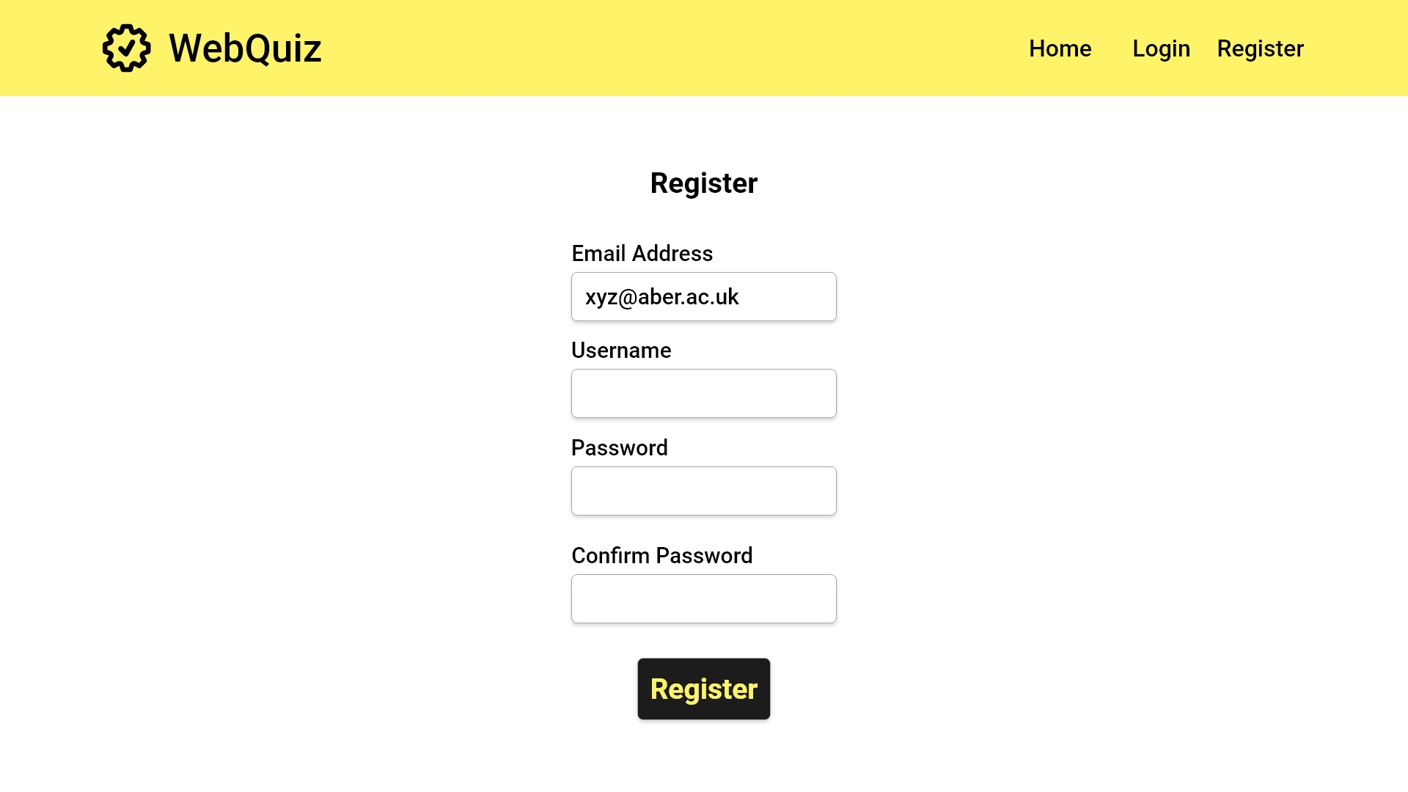

Slide 6
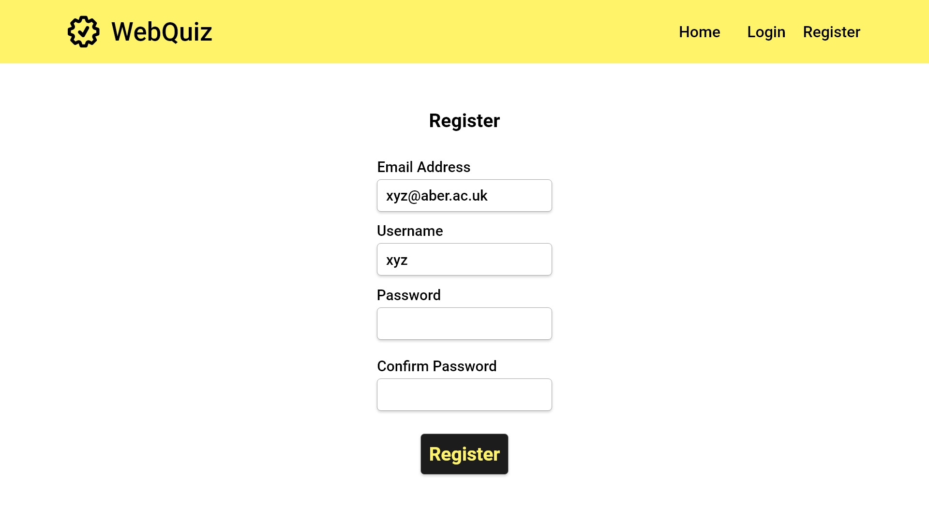

Slide 7


Slide 8


Slide 10
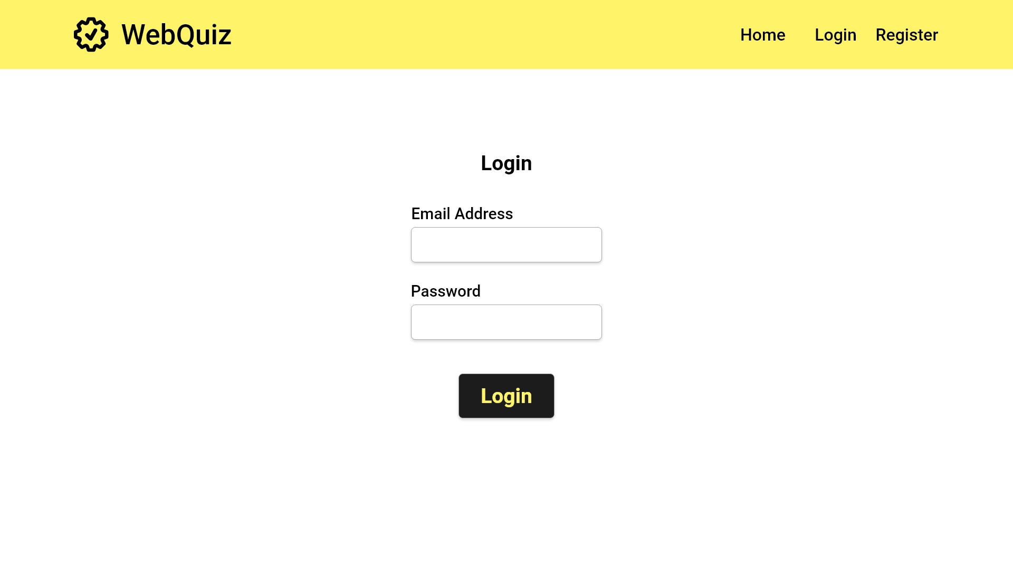
USE CASE 1.1
Quiz Maintainer login
USE CASE 2.1
Quiz Master login
Error Case

Slide 11
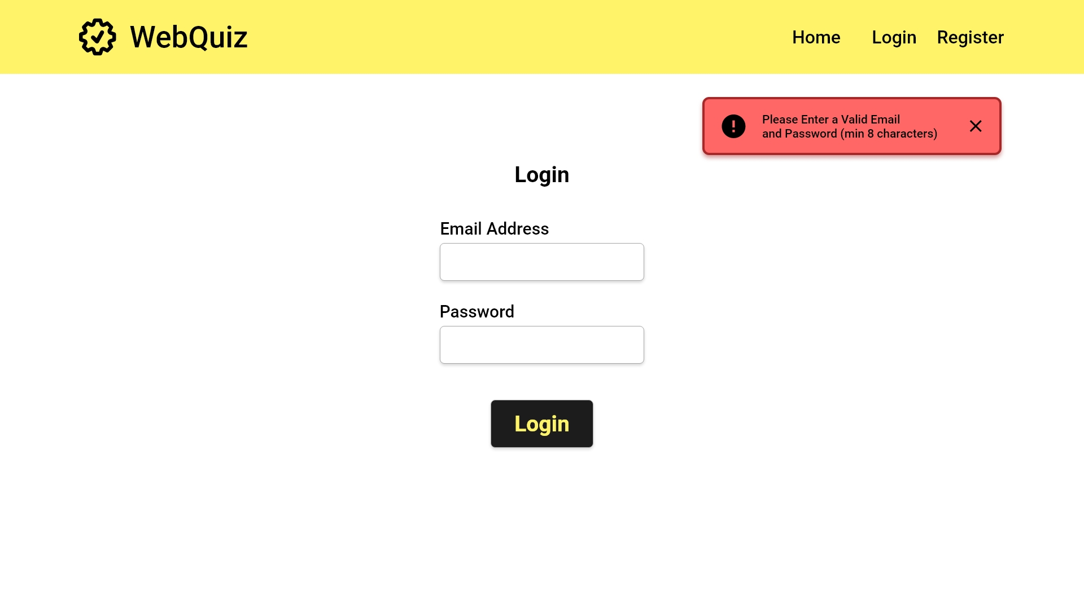

Slide 13
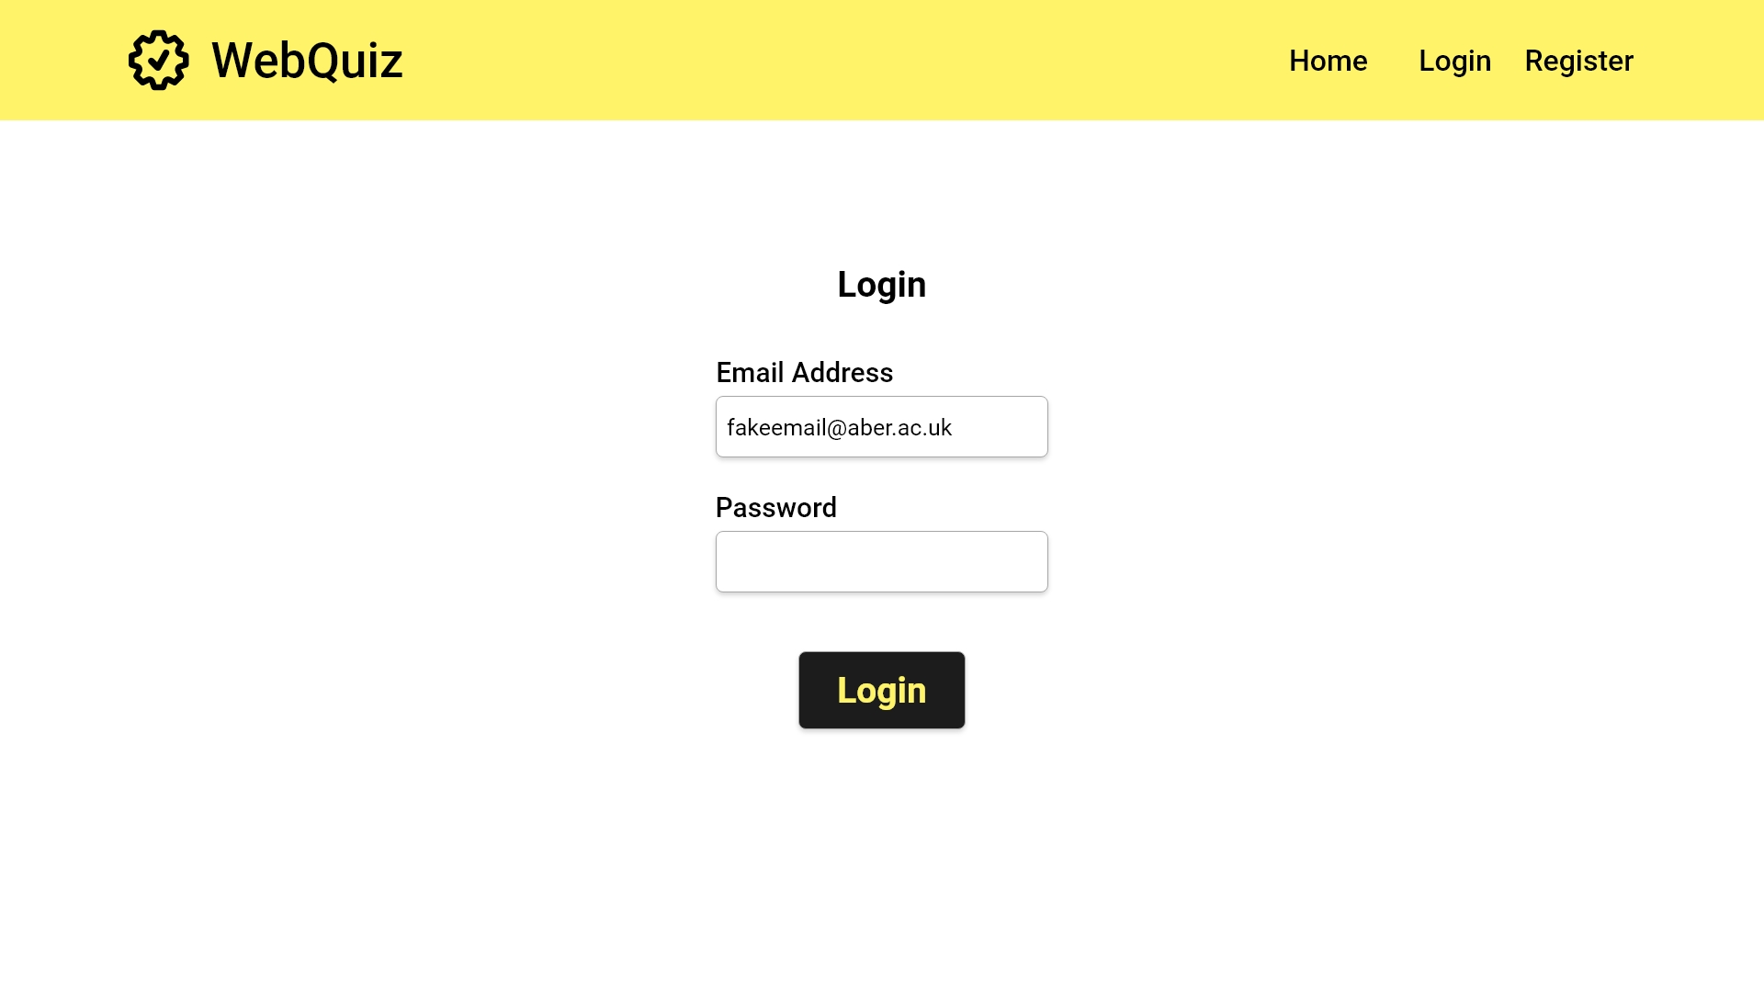

Slide 14
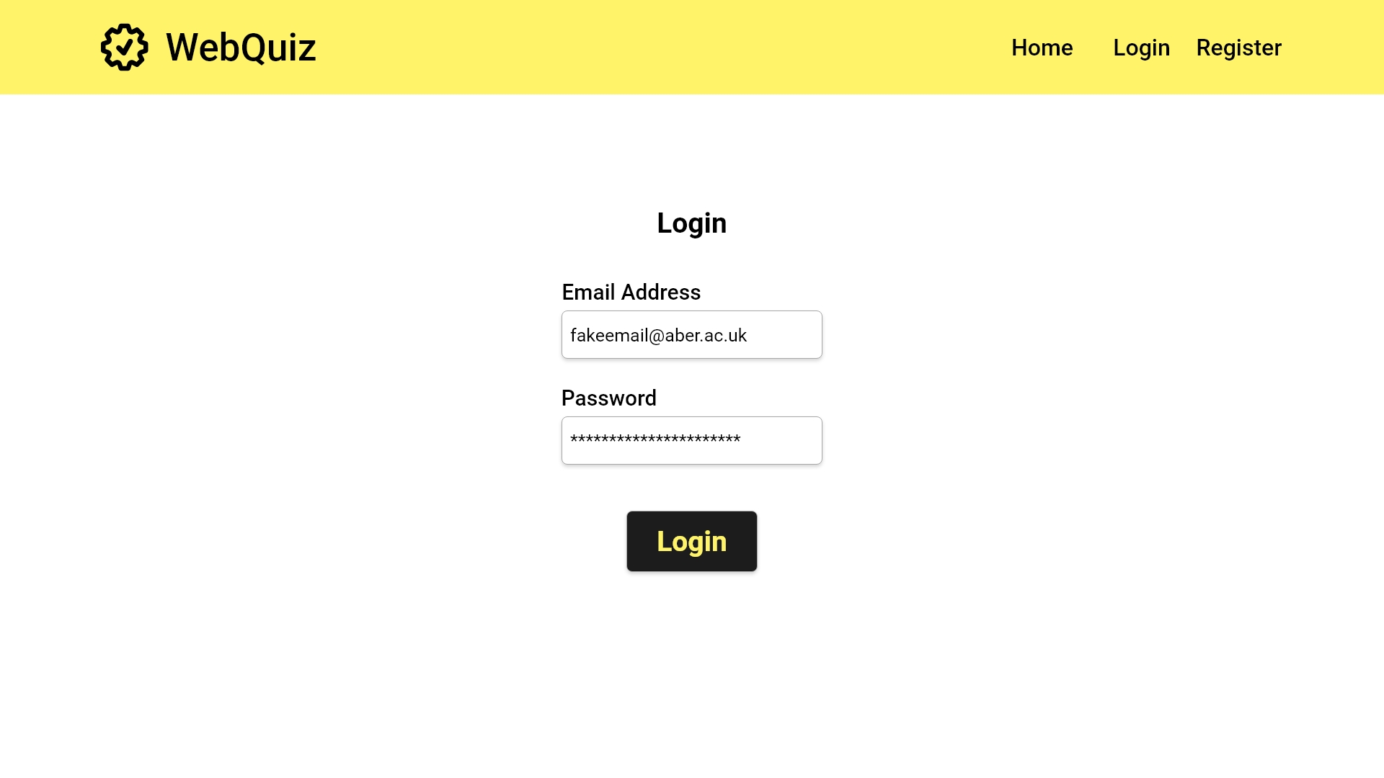

Slide 15
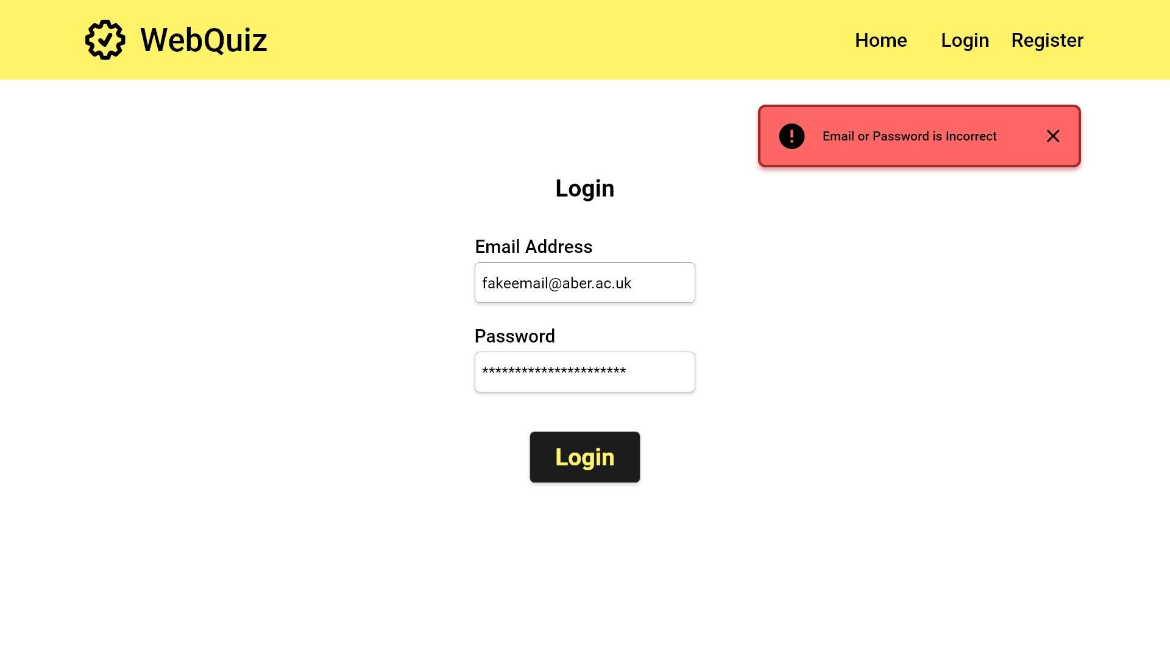

Slide 16


Slide 17
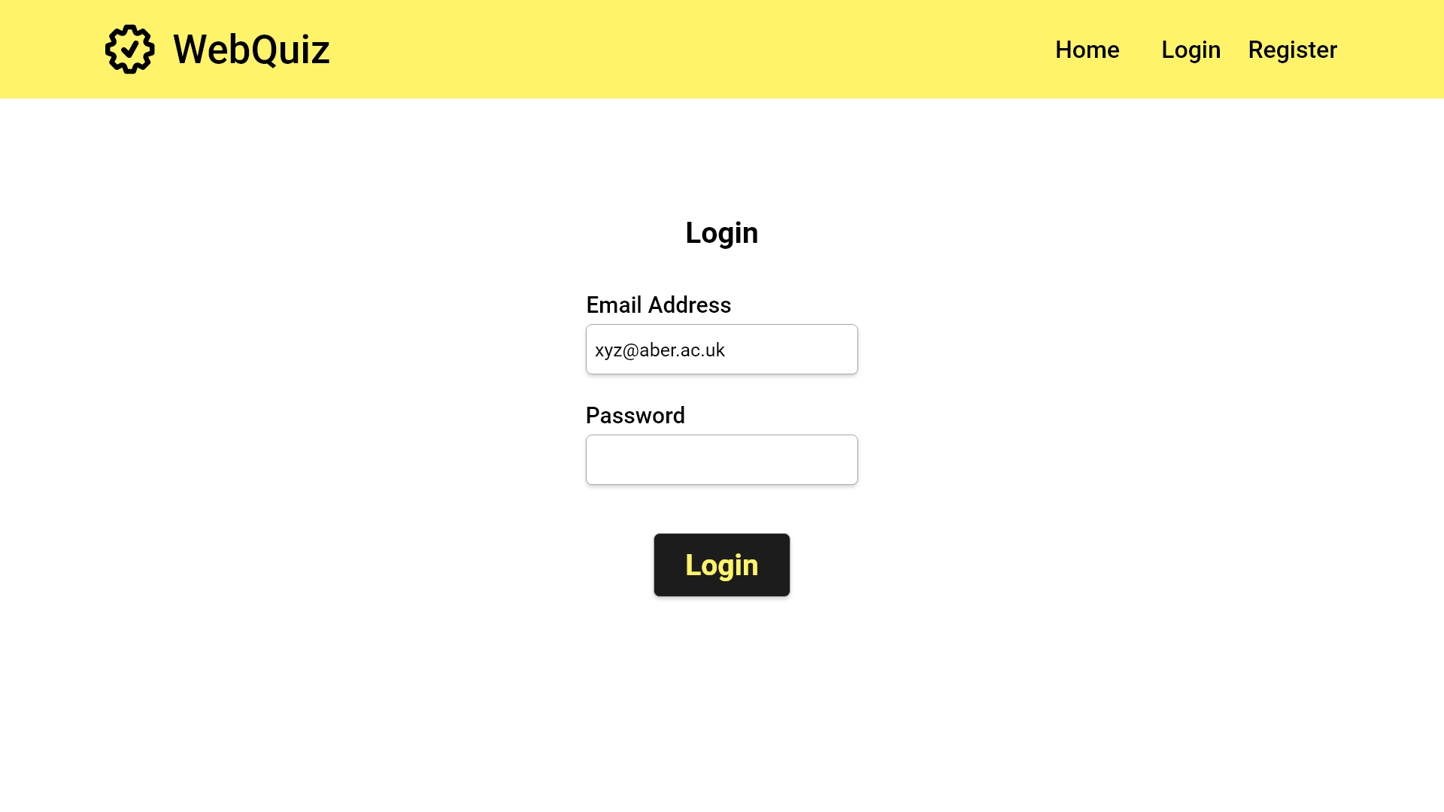

Slide 18


Slide 19
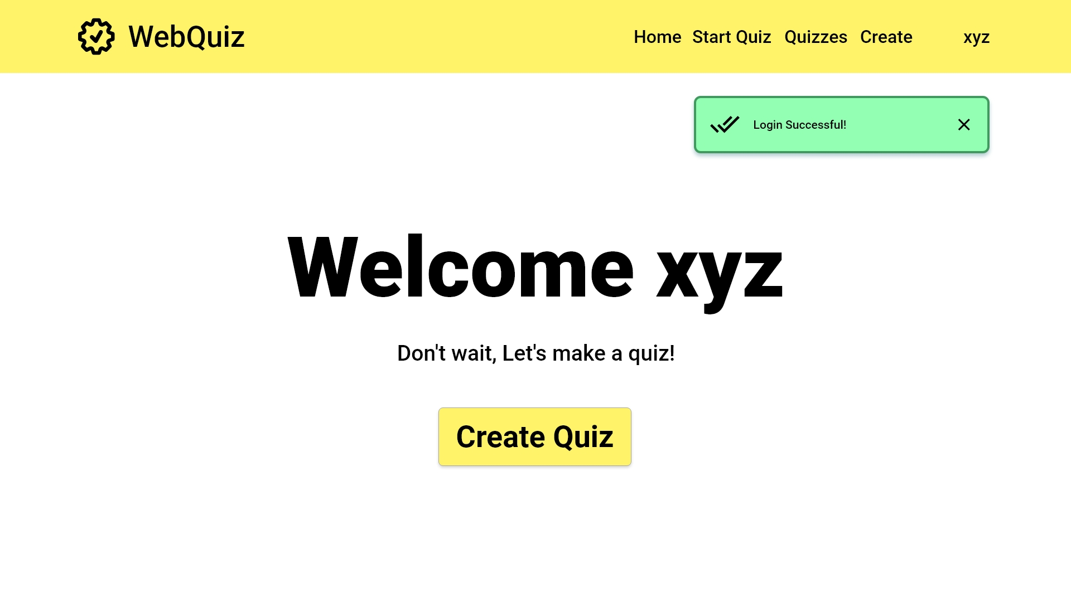
Close success message
Start Quiz Creation

Slide 20
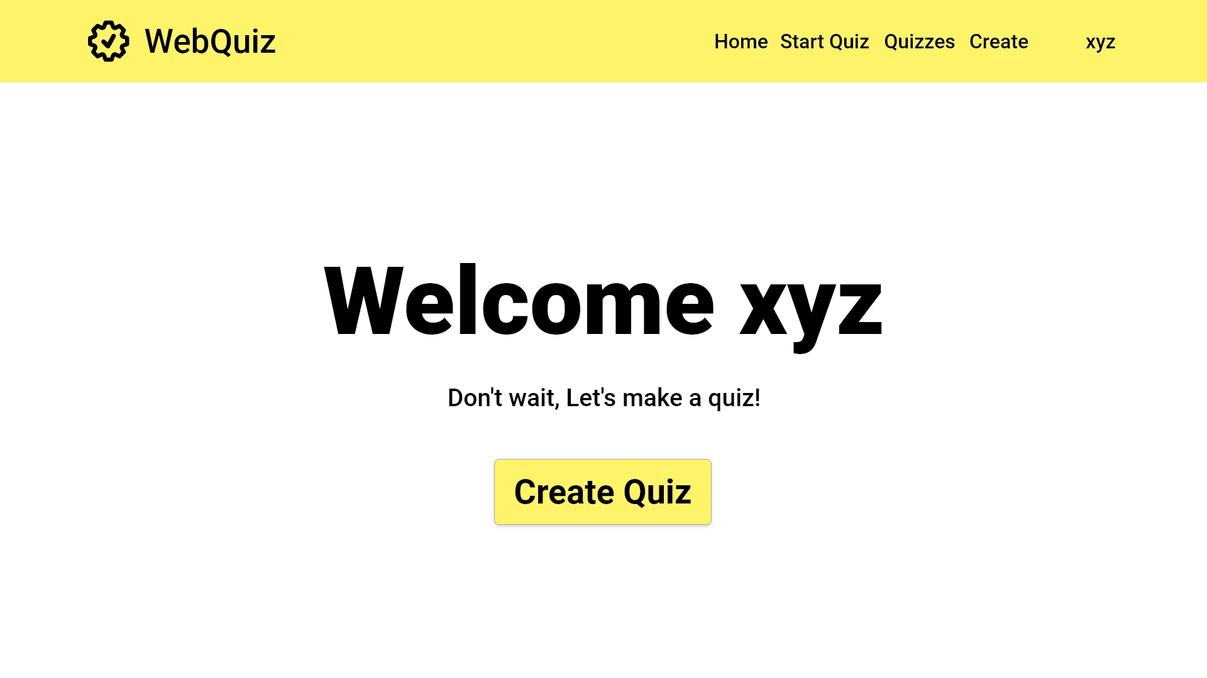
Start Quiz Creation
Start Quiz Creation
Switch to mobile view

Slide 21
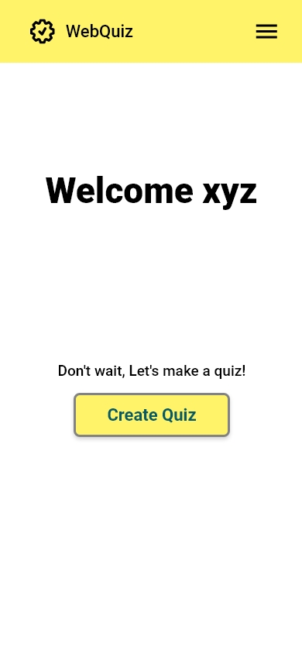
EIR2 Responsive web design
Switch to desktop view

Slide 22
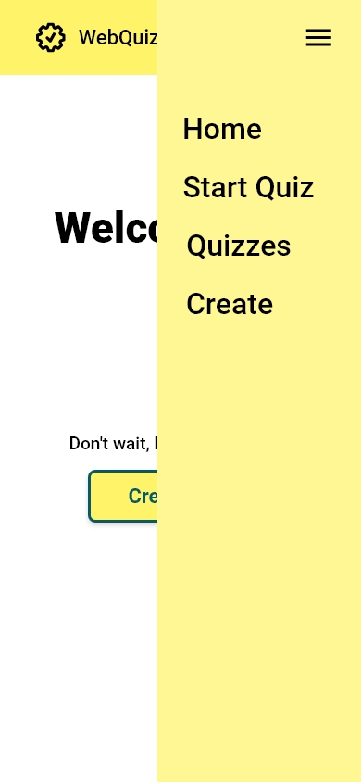
Switch to desktop view

Slide 24
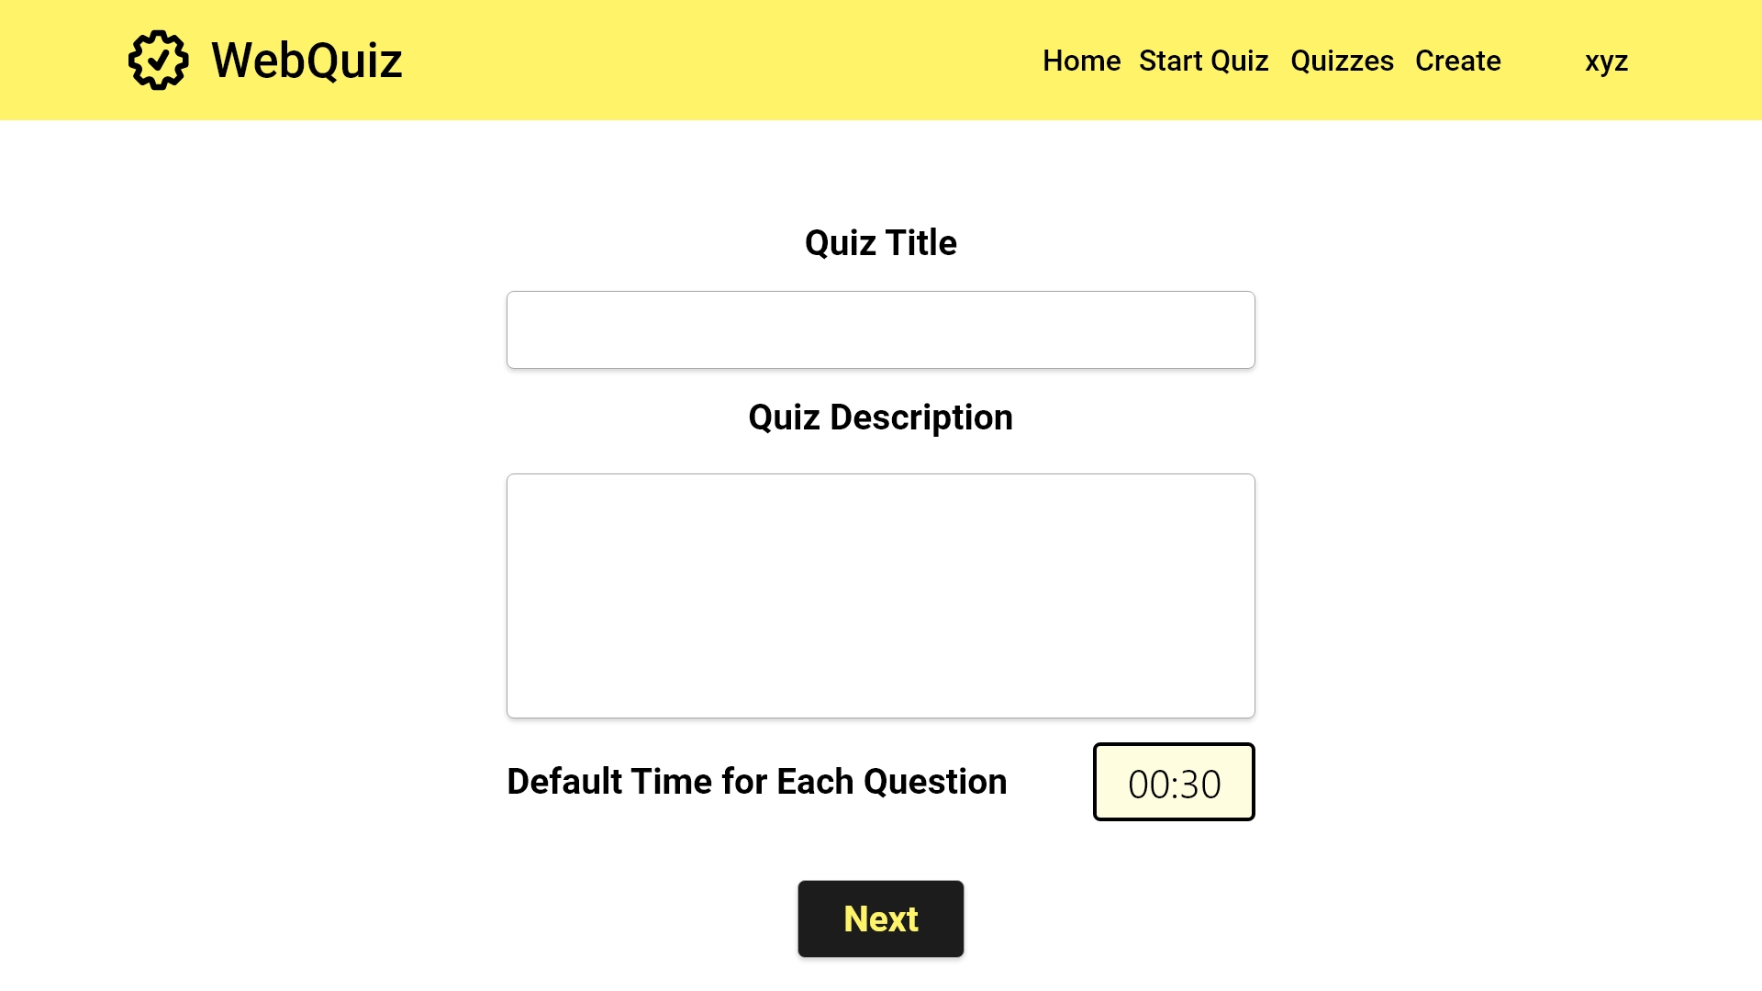
[FR1]: The quiz maintainer is able to create a quiz with a title
[FR1]: The quiz maintainer can enter a description for the quiz here
USE CASE 1.2
Quiz Maintainer create quiz
[FR4]: The default question time is 30; this can be altered

Slide 25
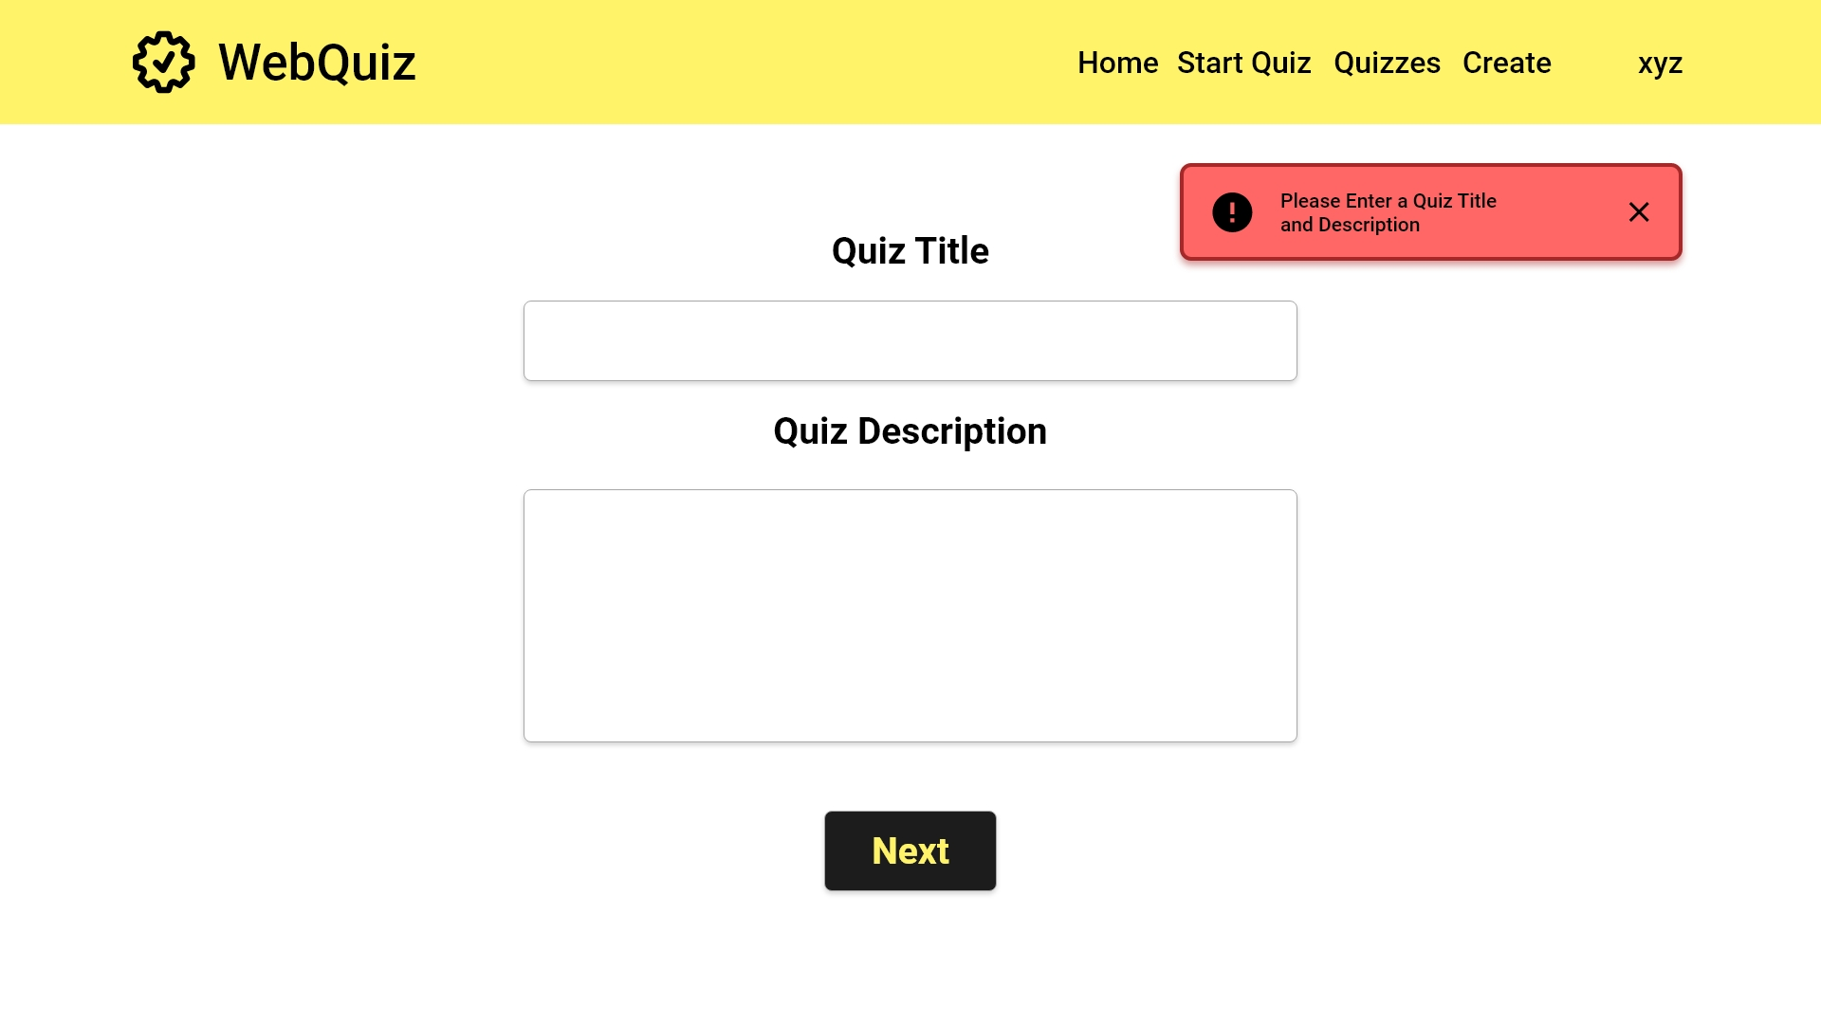
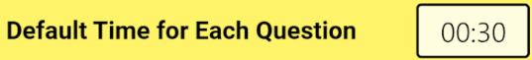

[FR1] Check if the title to the new quiz is given

Slide 26
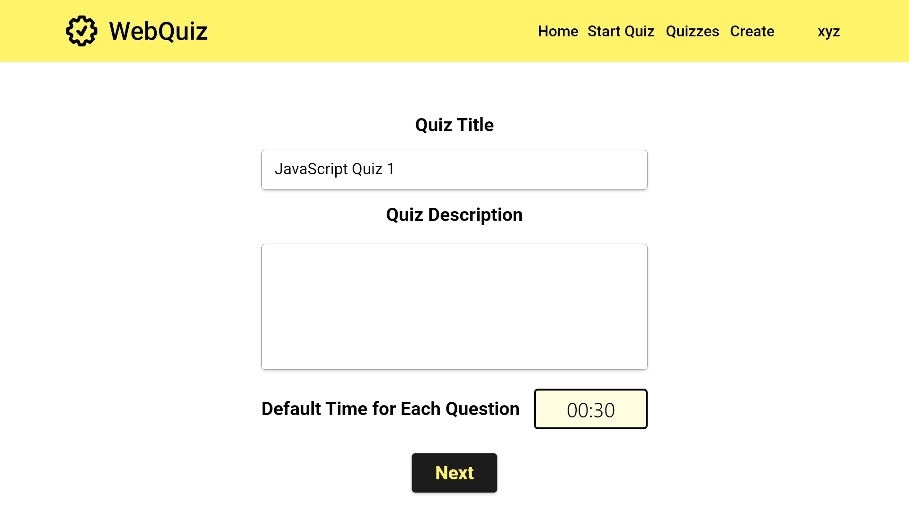

Slide 27
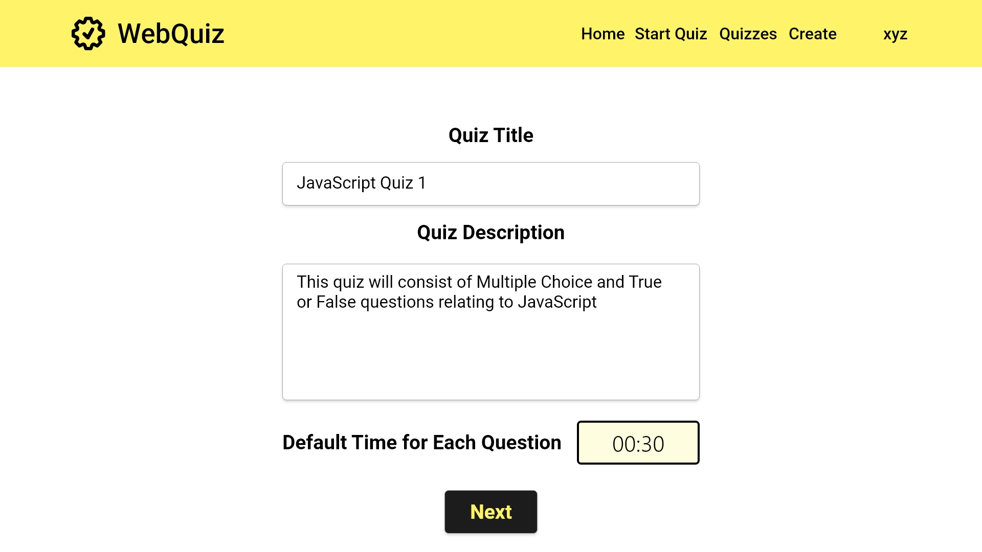

Slide 28
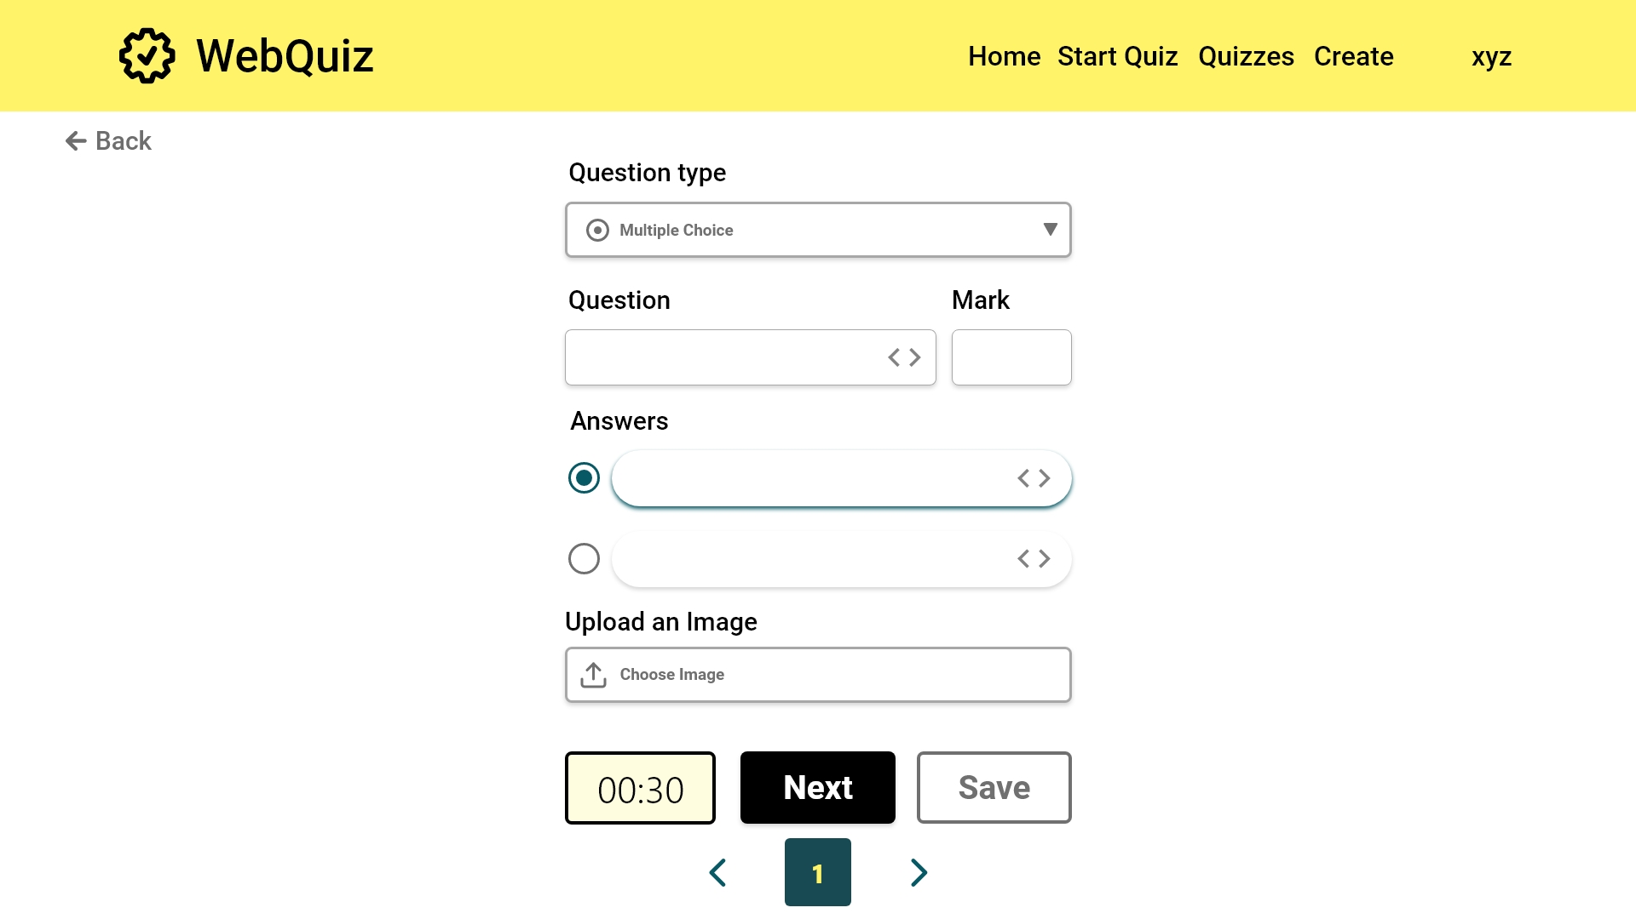
USE CASE 1.2
Quiz Maintainer create quiz
[FR2]: The quiz maintainer can create a multiple choice quiz
[FR2]: A mark can be set for the question here
[FR2]: A question must be entered in the box
[FR2]: Multiple choices can be set. The minimum is 2. Check the correct answers
[FR2]: An accompanying image can be uploaded
[FR4]: The default timer is applied. This can be changed on as needed
Error case

Slide 29
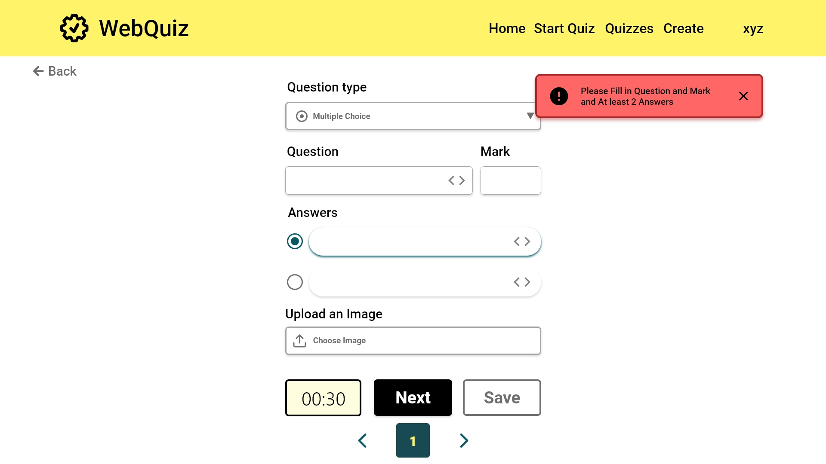
[FR2] Check if the new question has the question text, two or more possible answers, an indication of which answers are correct, a mark for each

Slide 30


Slide 31


Slide 32


Slide 33
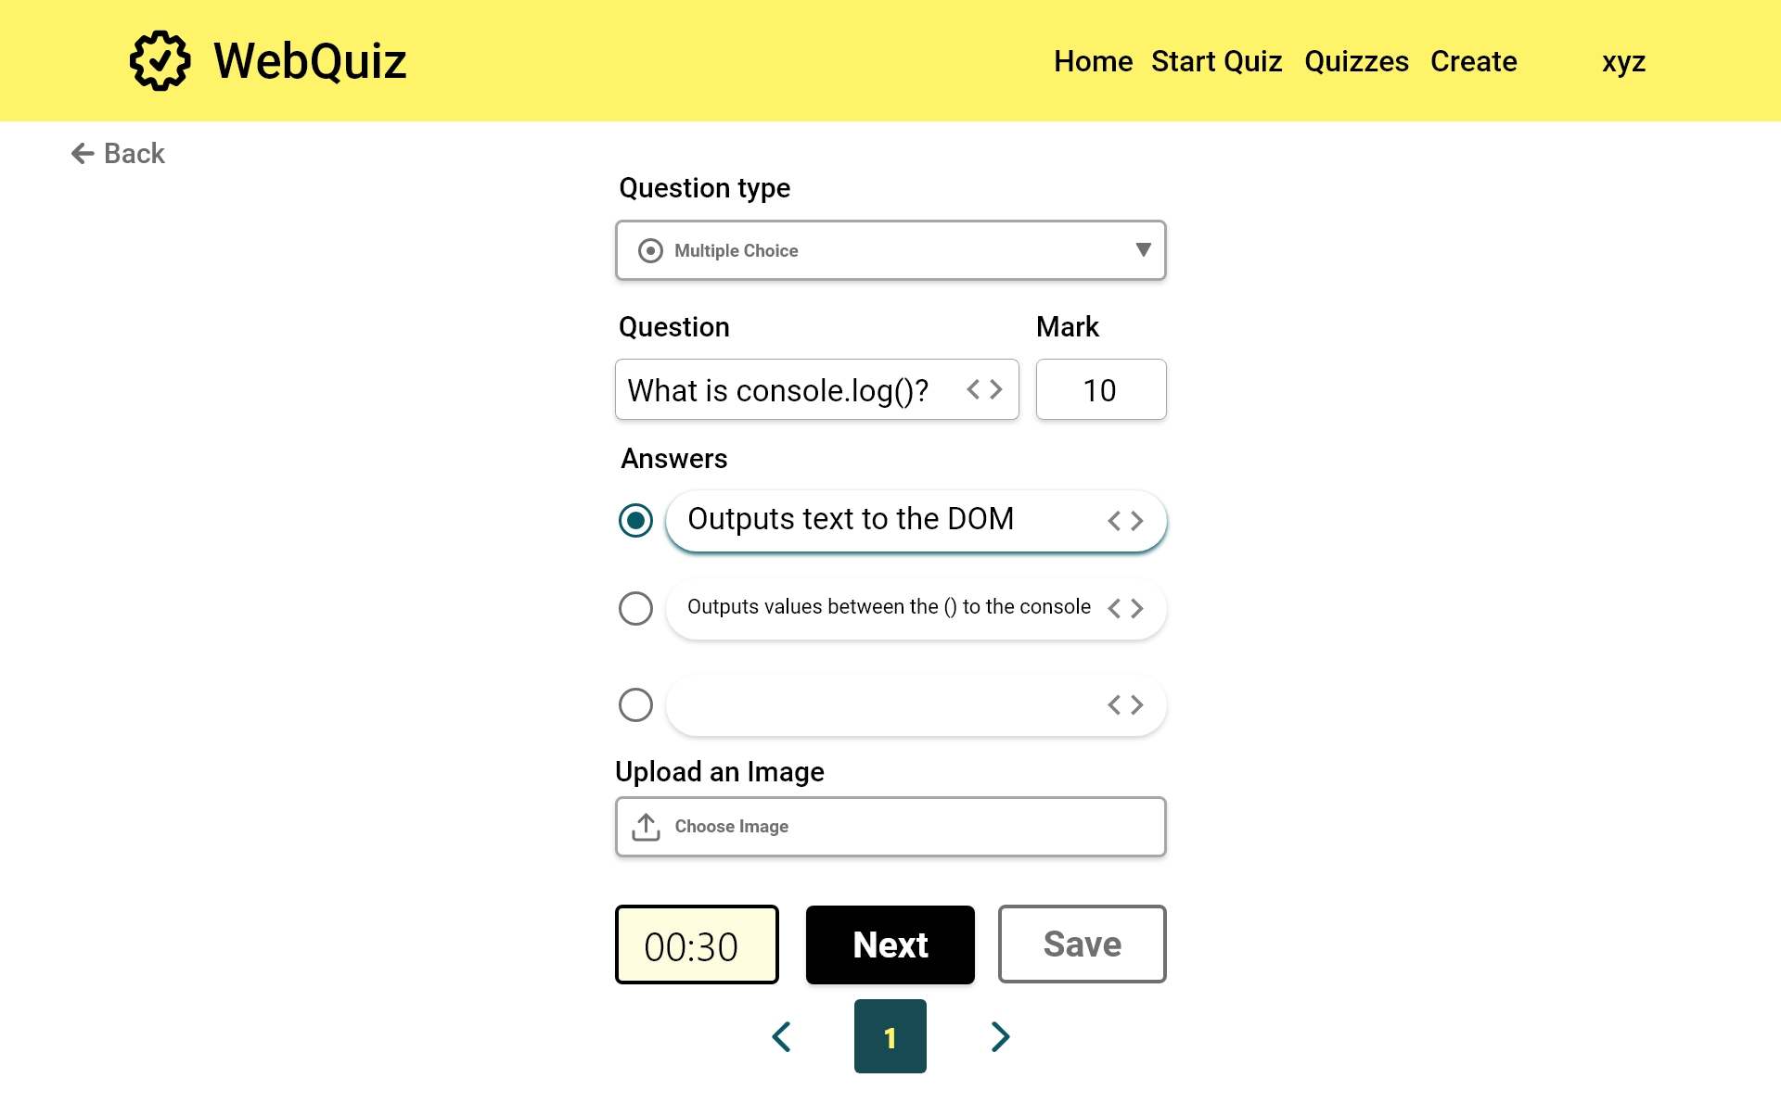
[FR2]: Additional answers are added as needed

Slide 34
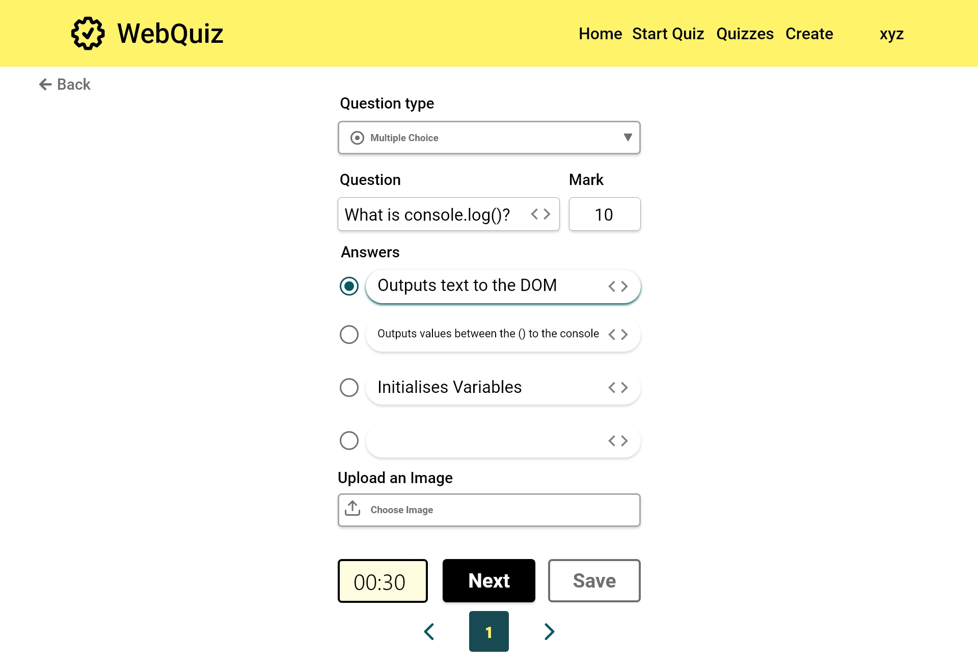
[FR2]: Additional answers are added as needed

Slide 35
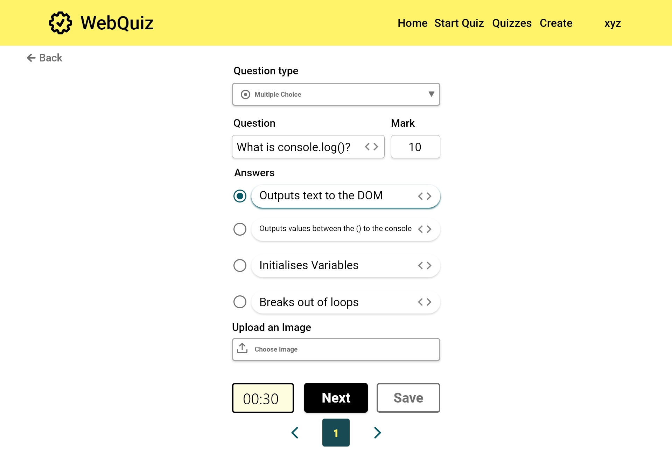
[FR2] Indicate a correct answer

Slide 36
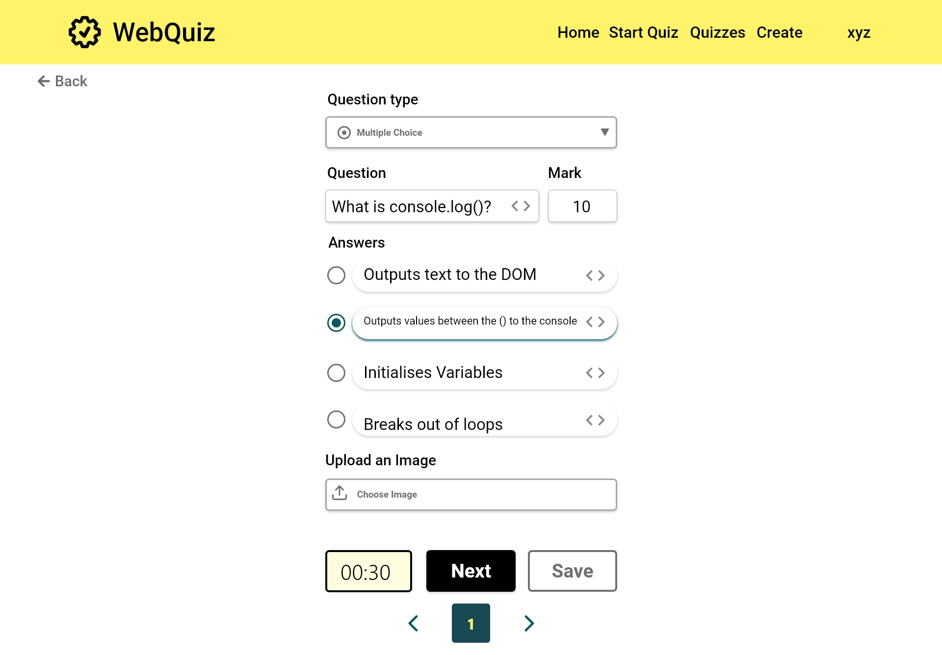

Slide 37
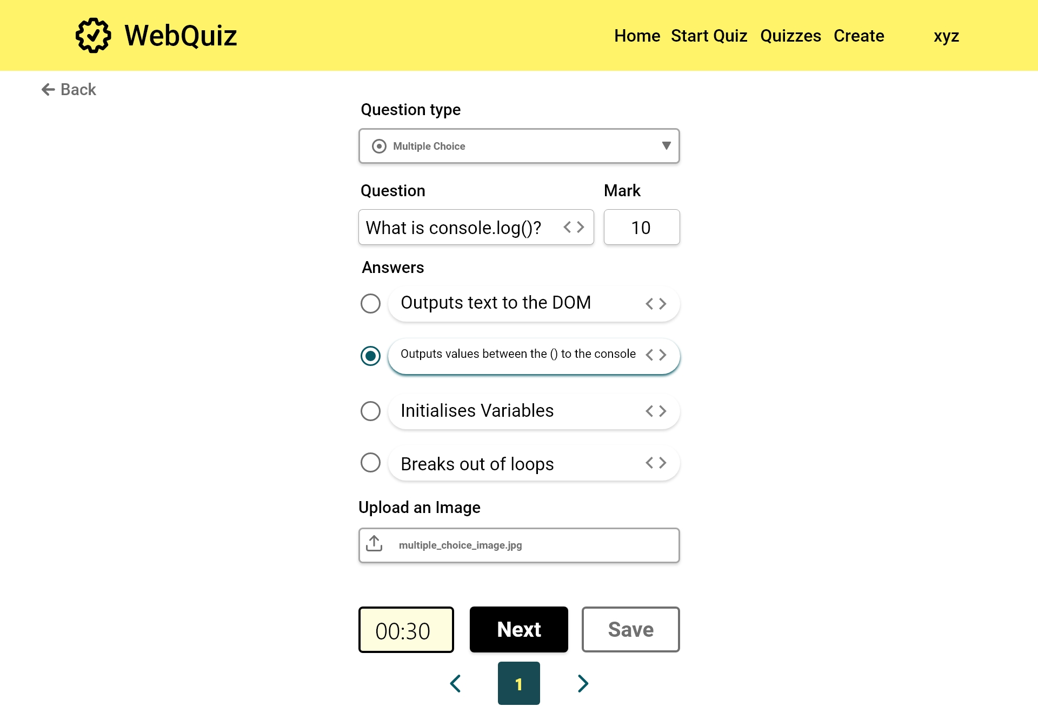

Slide 38
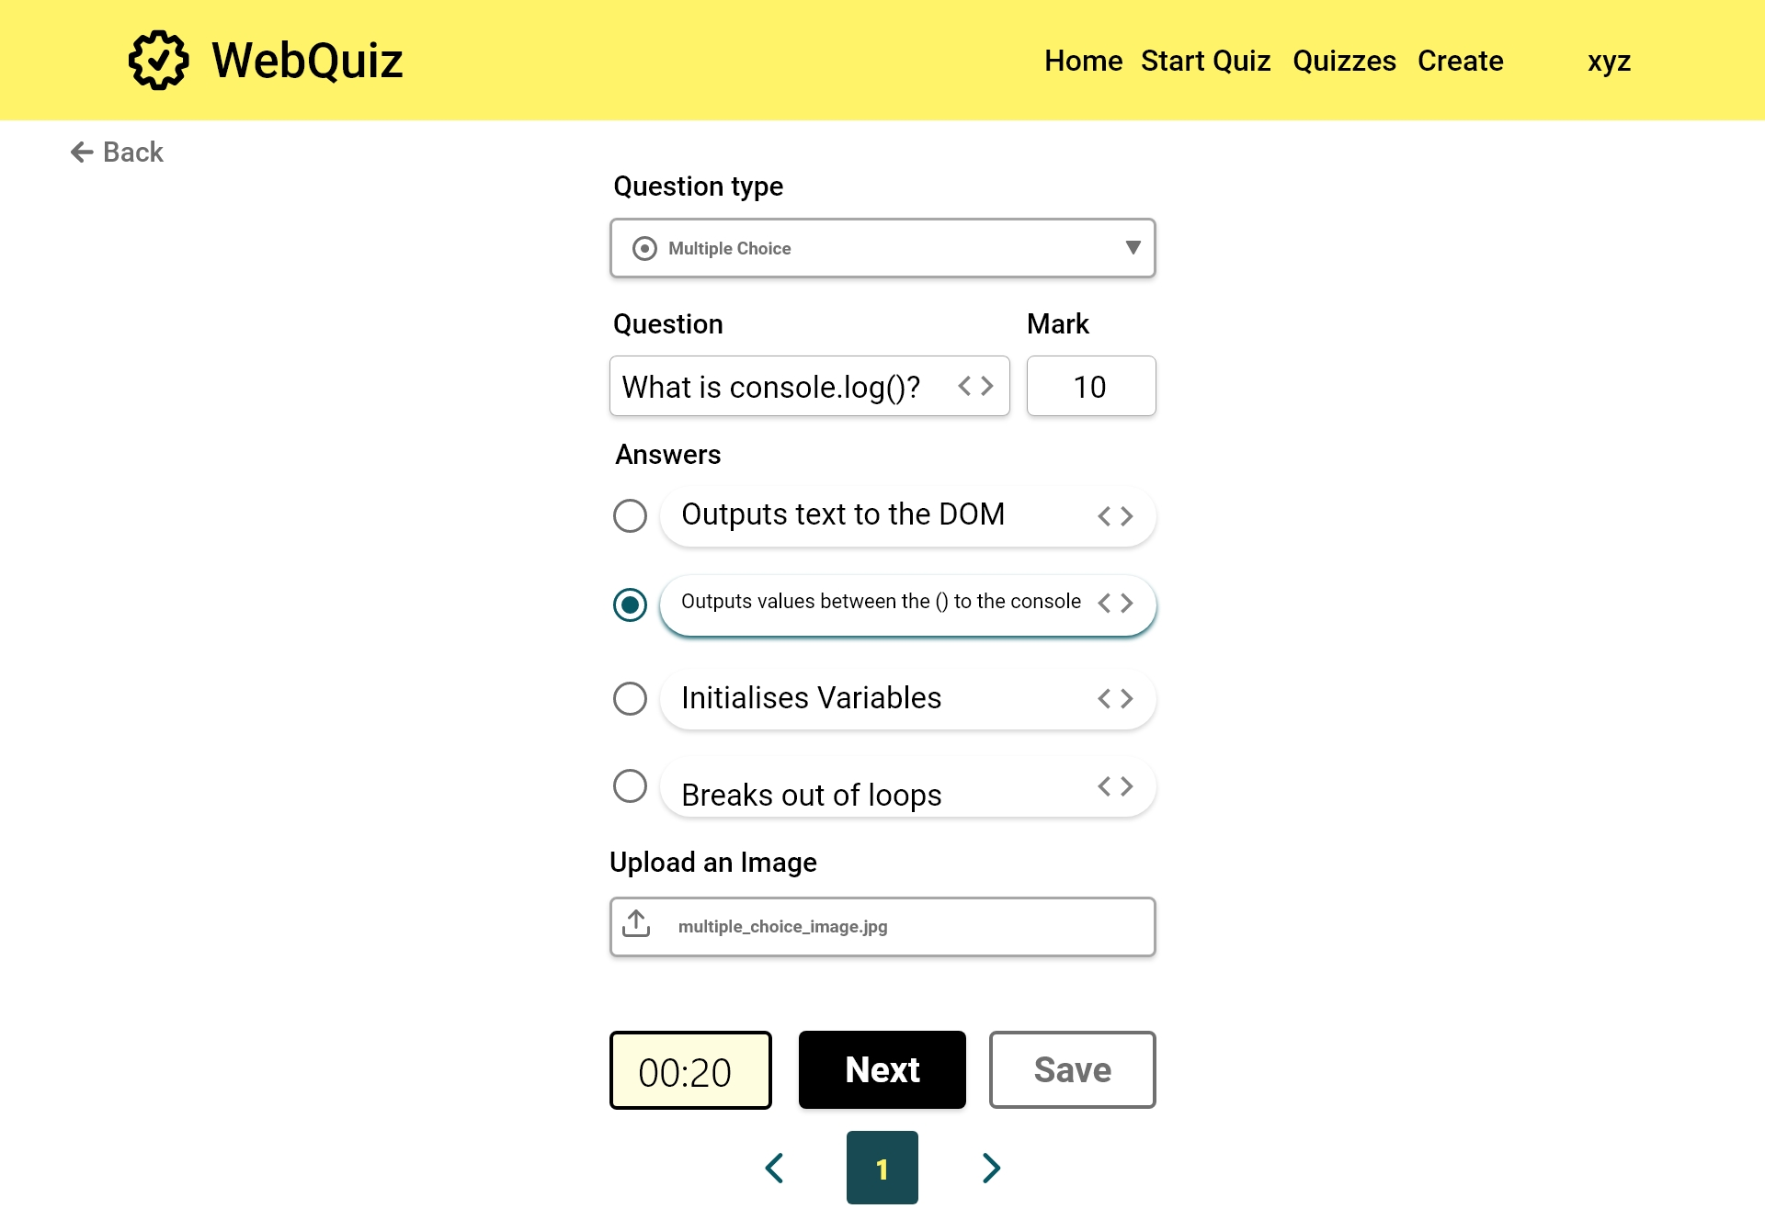

Slide 39
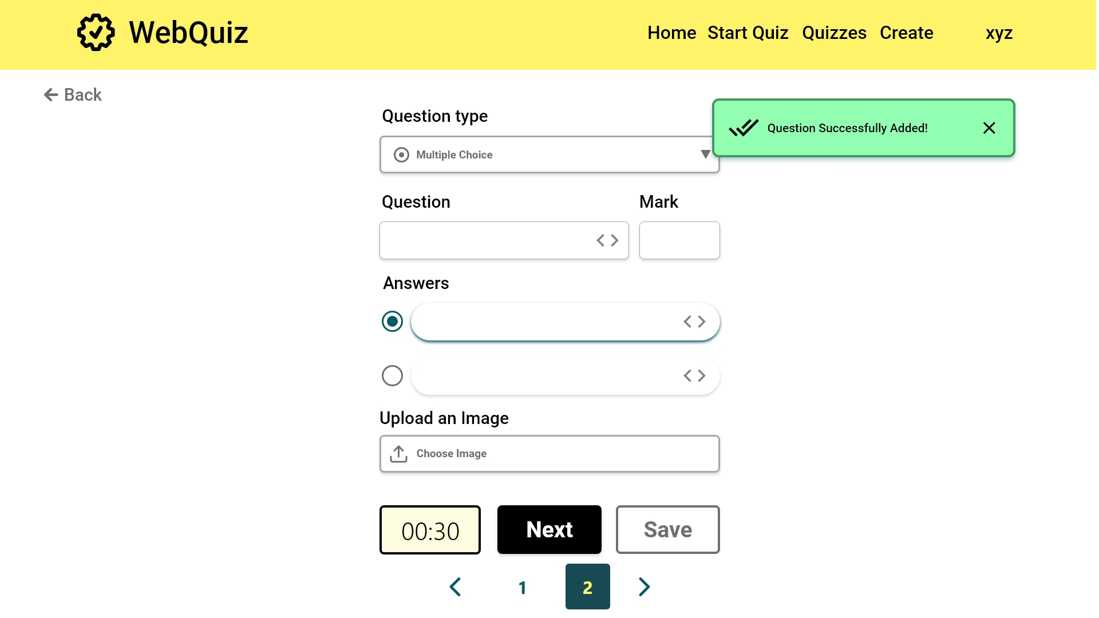
[FR6]: The navigation bar can be used to edit questions

Slide 40
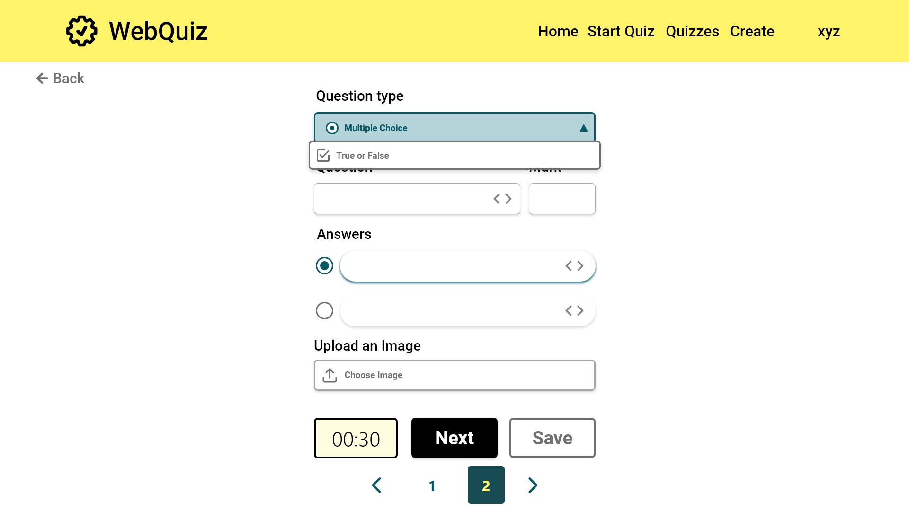
[FR3]: The quiz maintainer can choose to create a true or false question

Slide 41
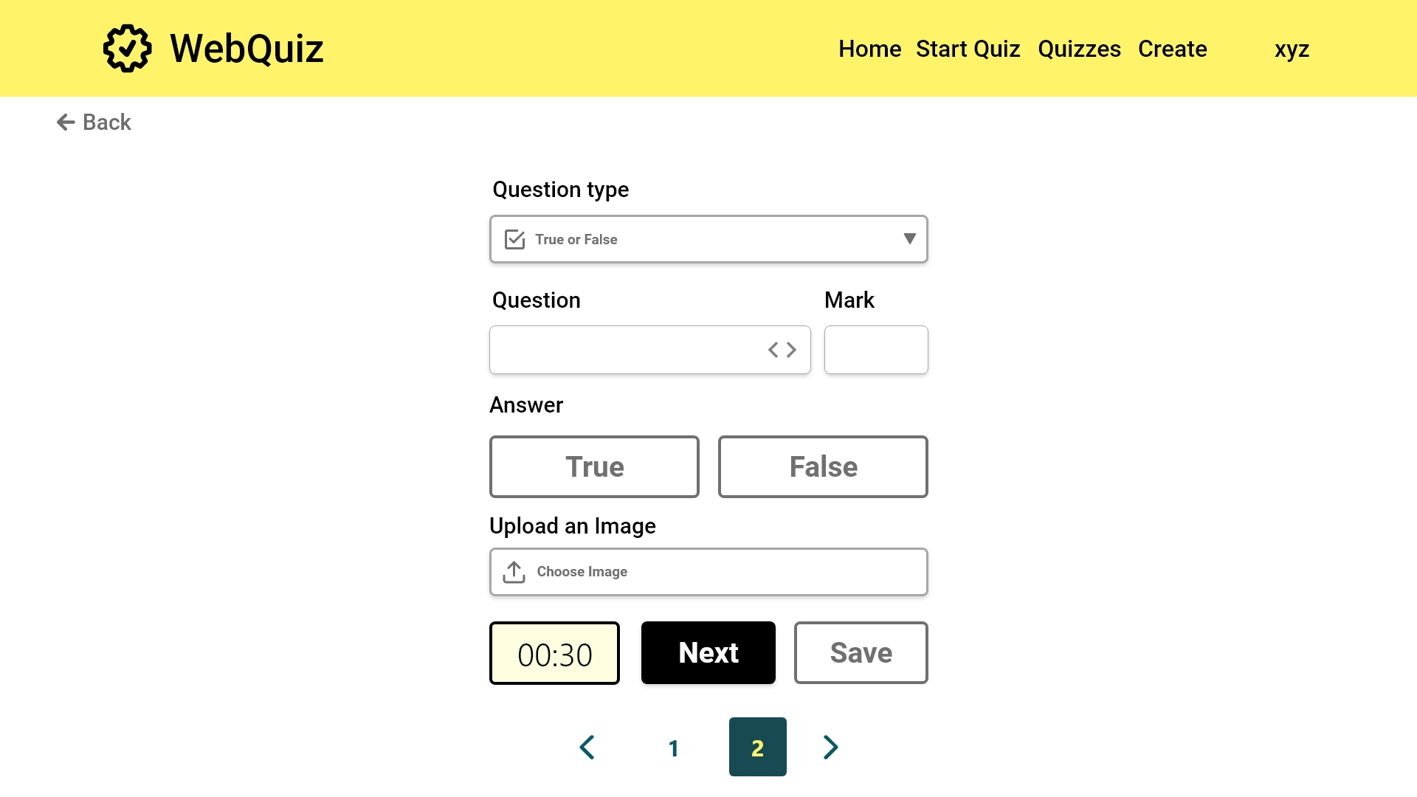
[FR4]: The user interface changes to accommodate the change in question type
[FR4]: The quiz maintainer can choose whether the answer is true or false
Error case

Slide 42
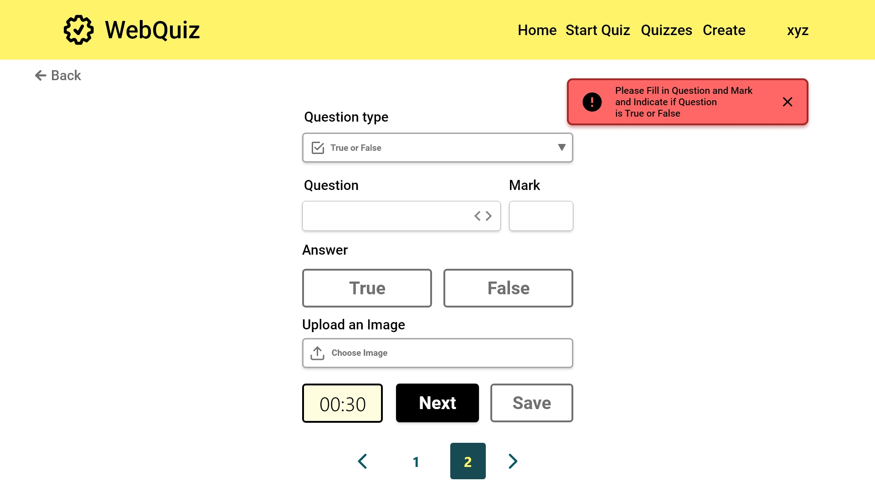
[FR3] Check if the new question has the question text, an indication of whether the answer should be true or false and a mark for each

Slide 43
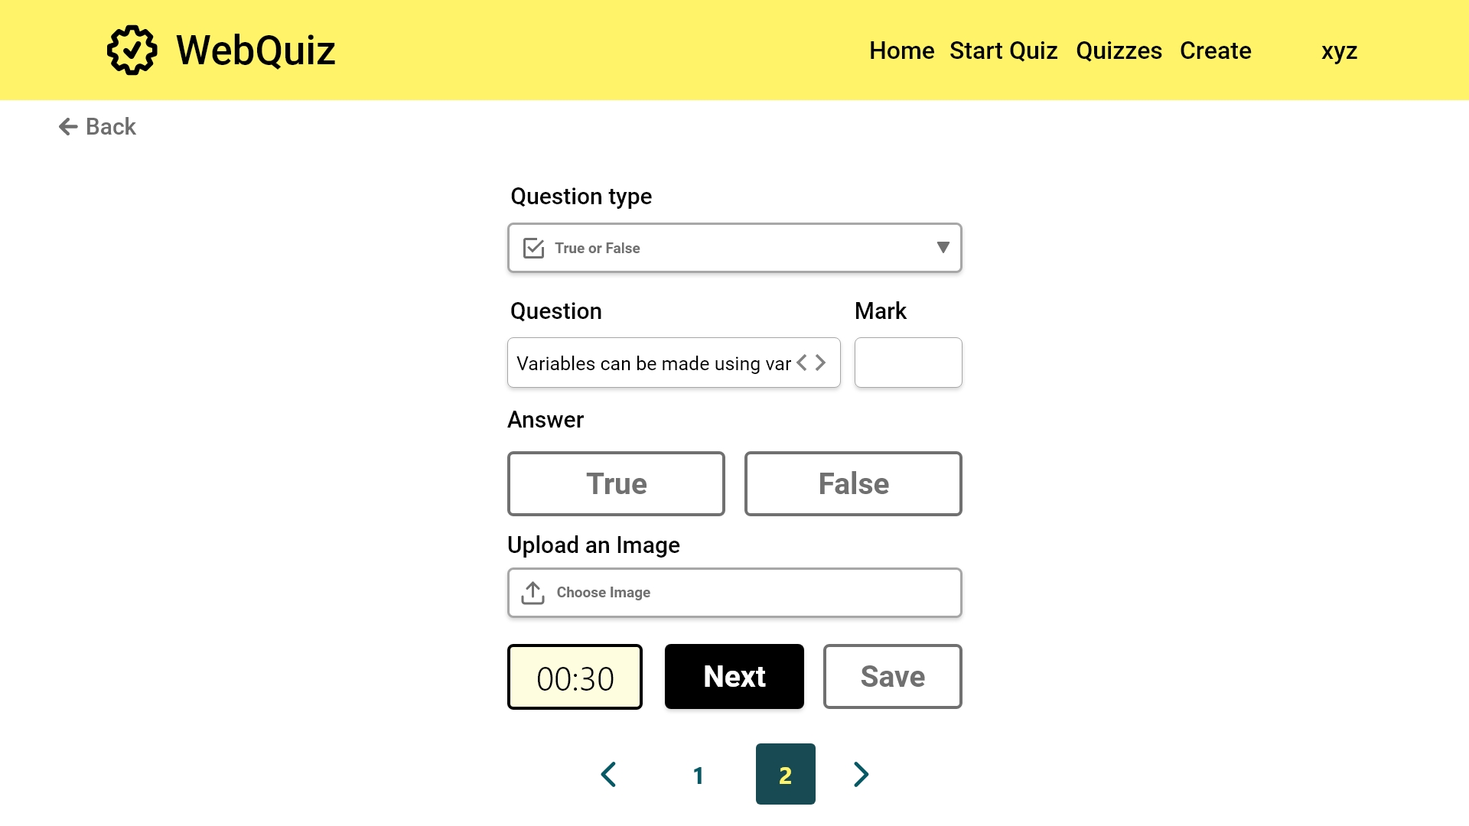

Slide 44



Slide 45
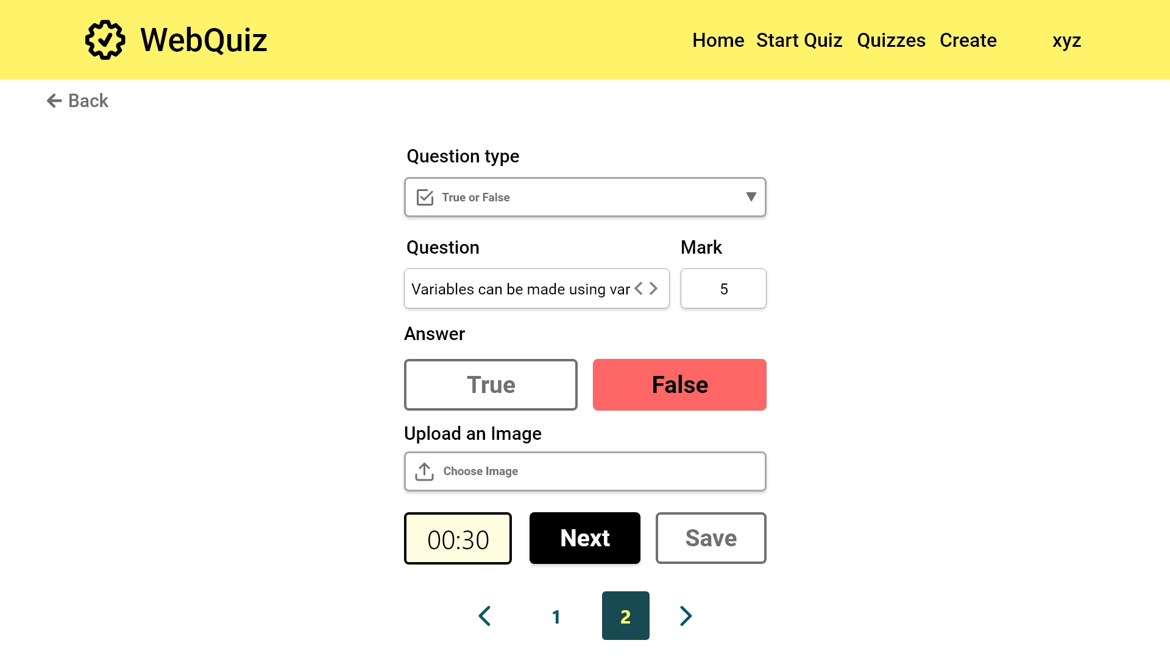

Slide 46
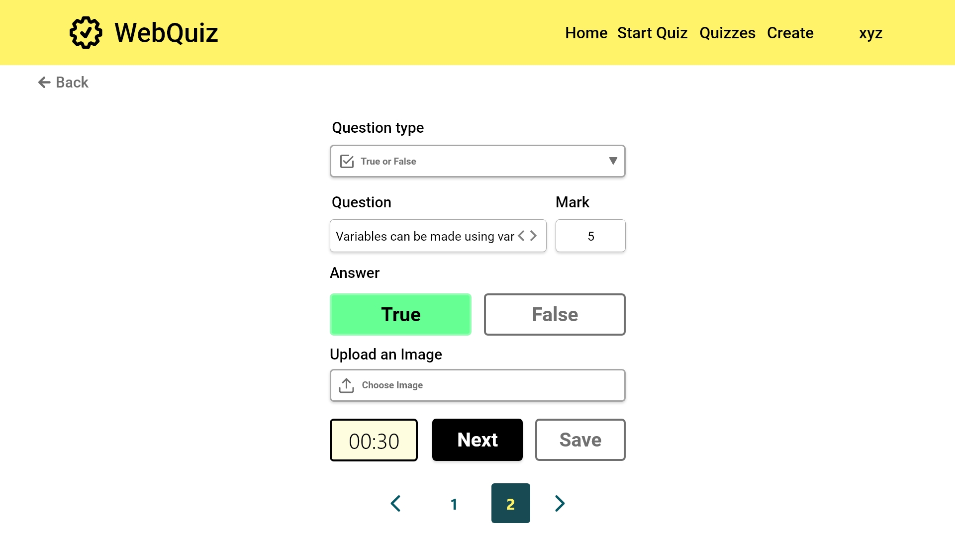

Slide 47


Slide 48


Slide 49
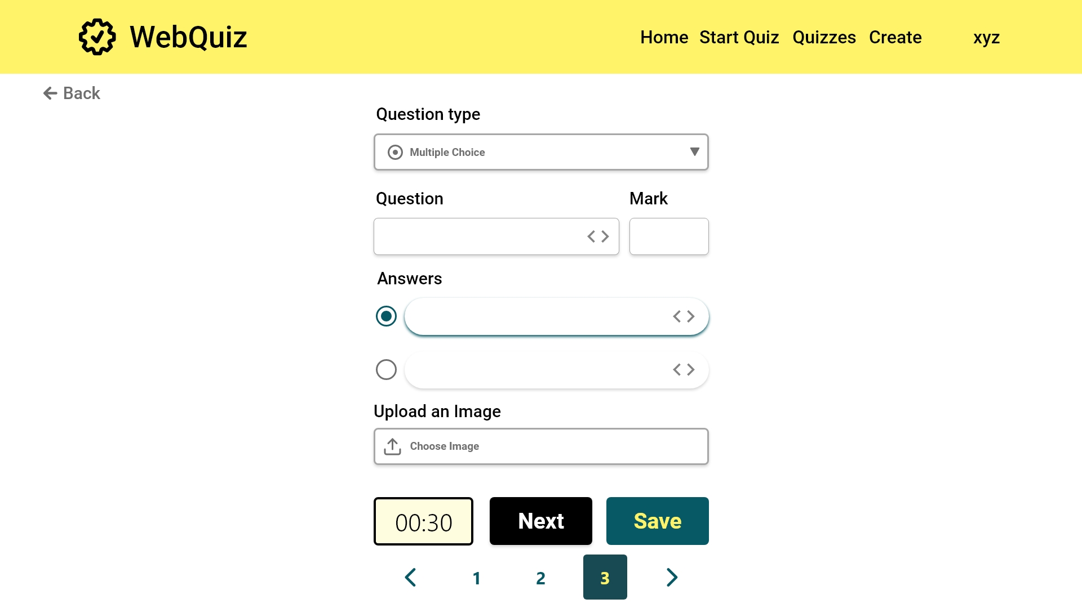

Slide 50


Slide 51


Slide 52
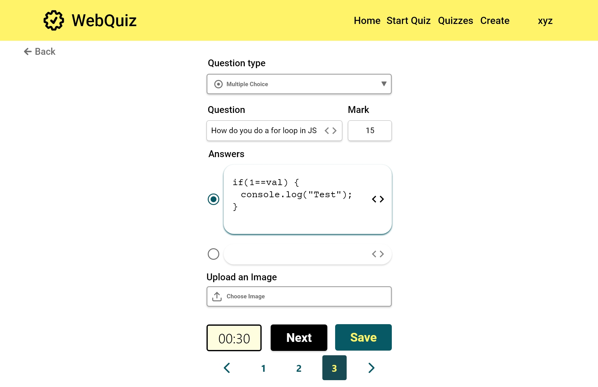

Slide 53
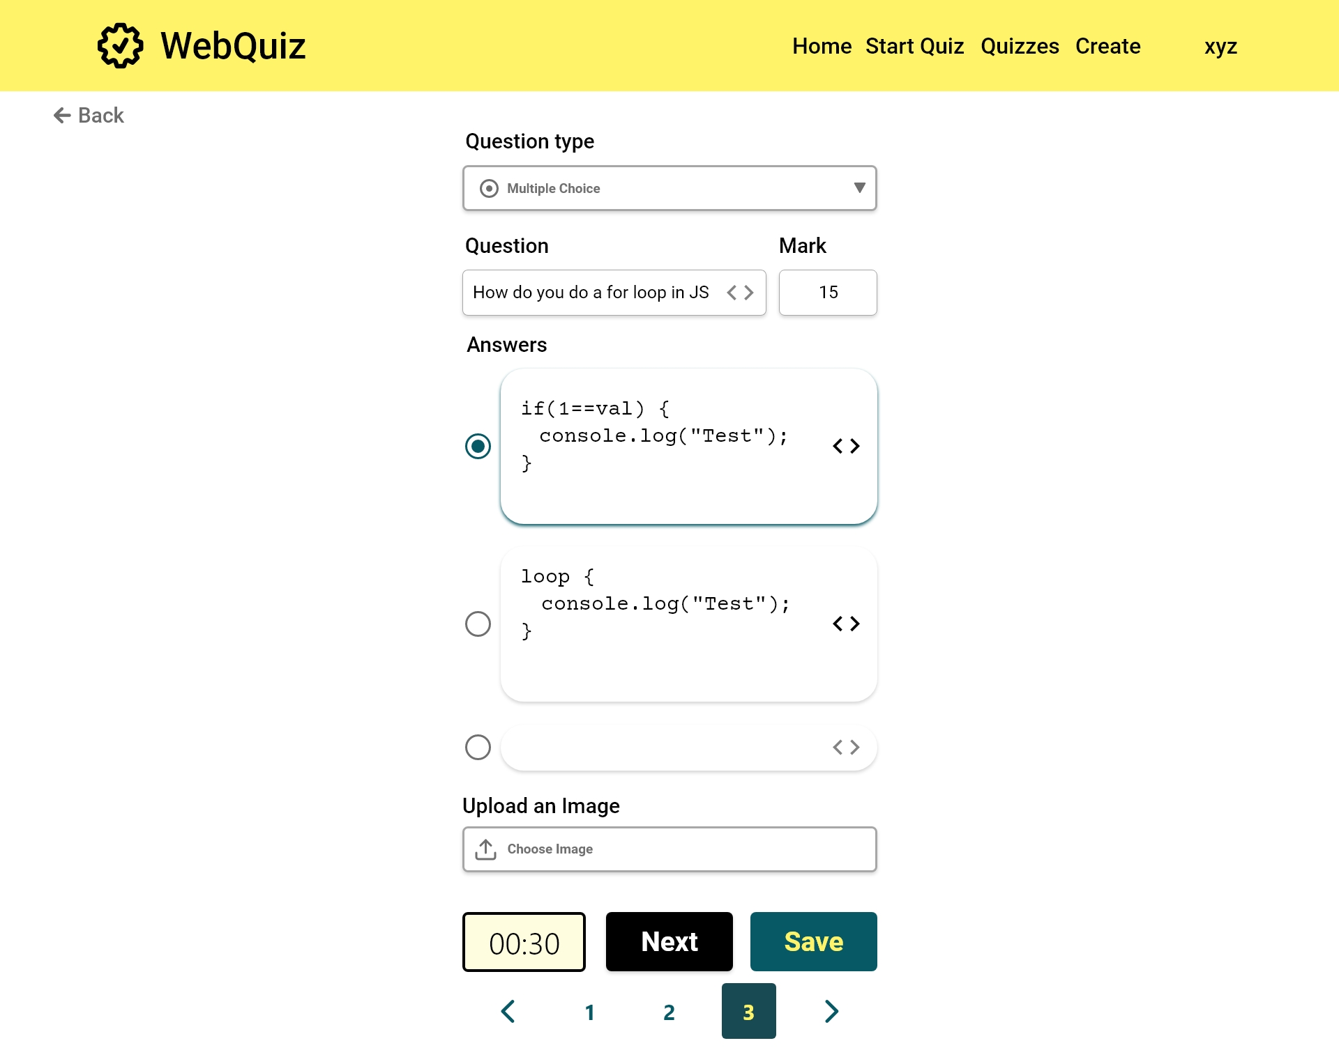

Slide 54
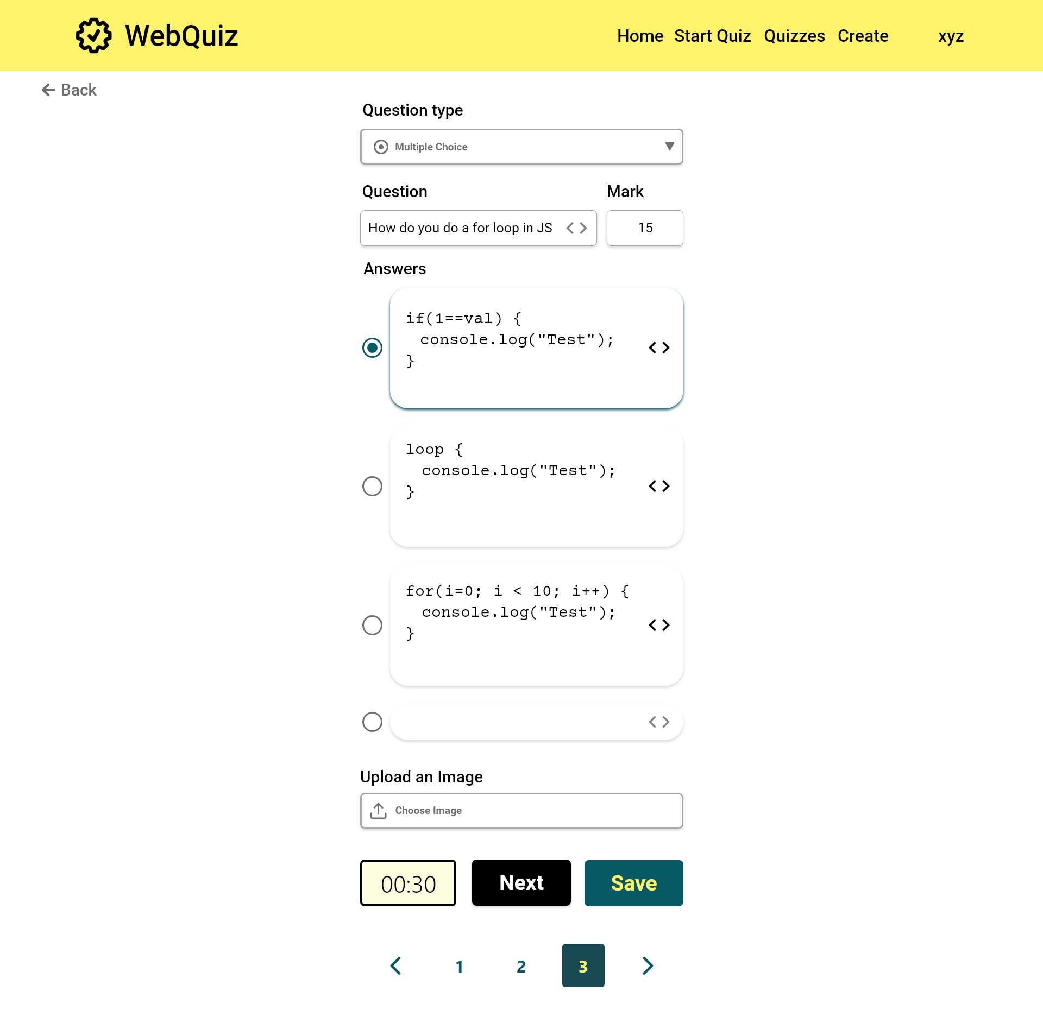

Slide 55
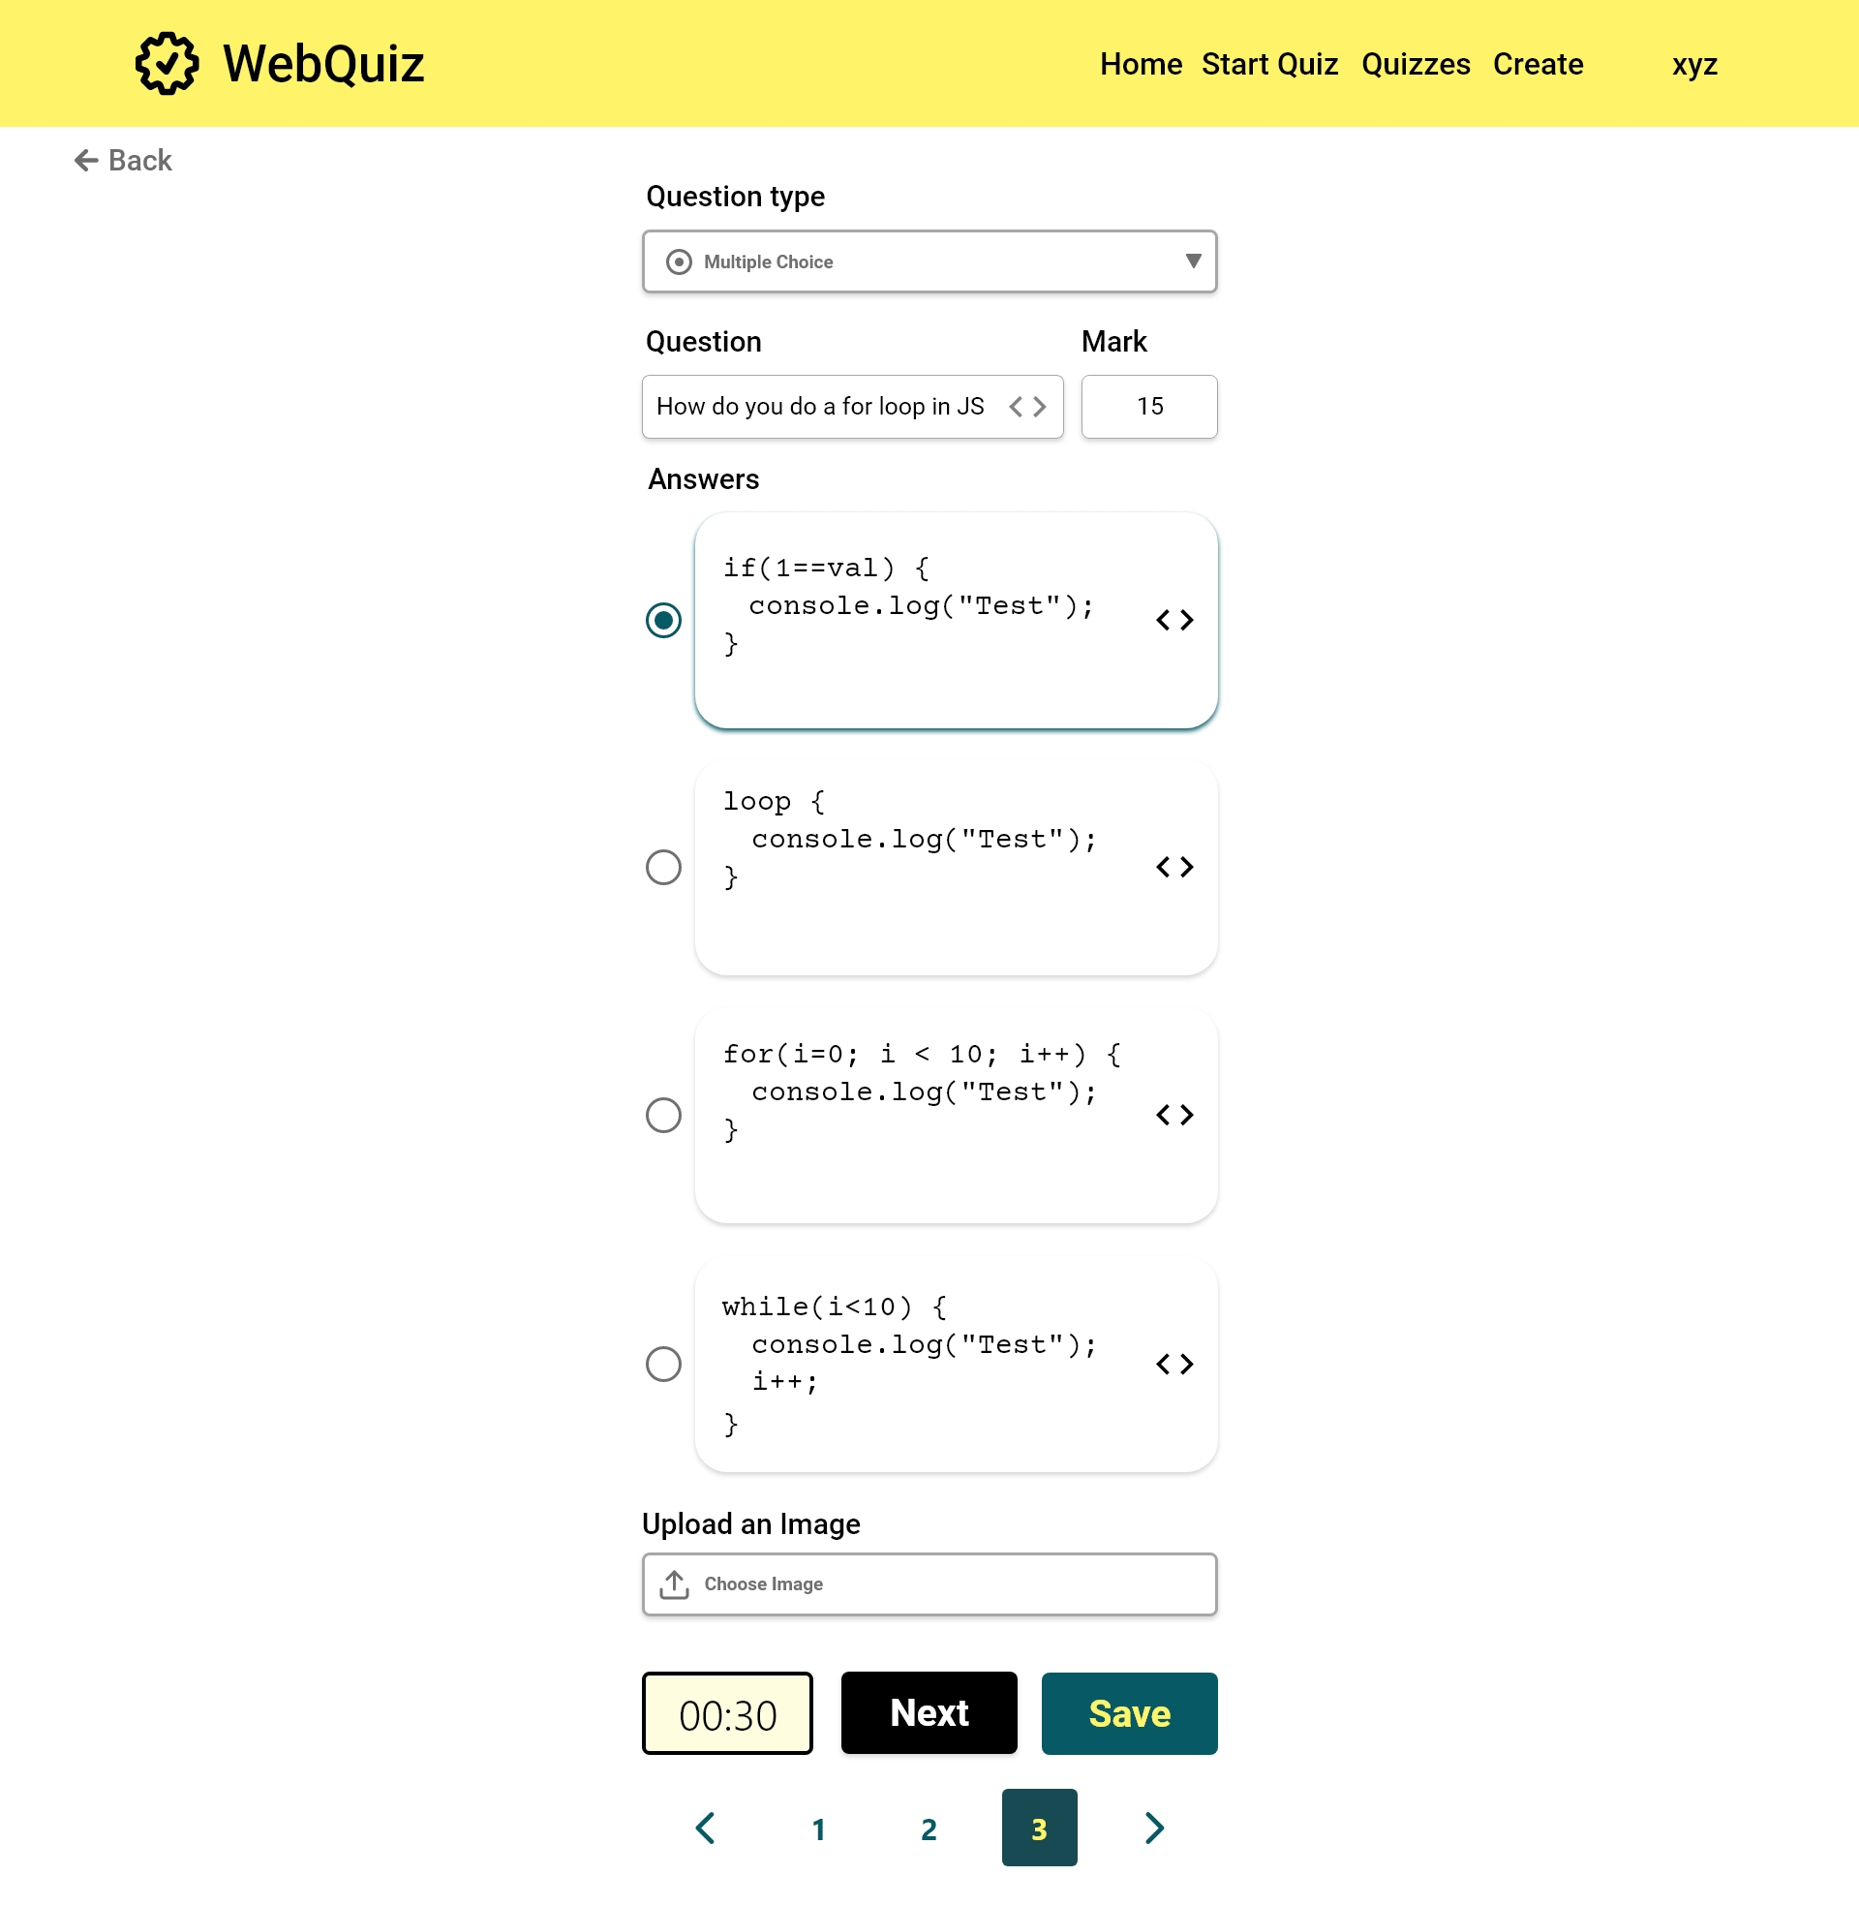

Slide 56
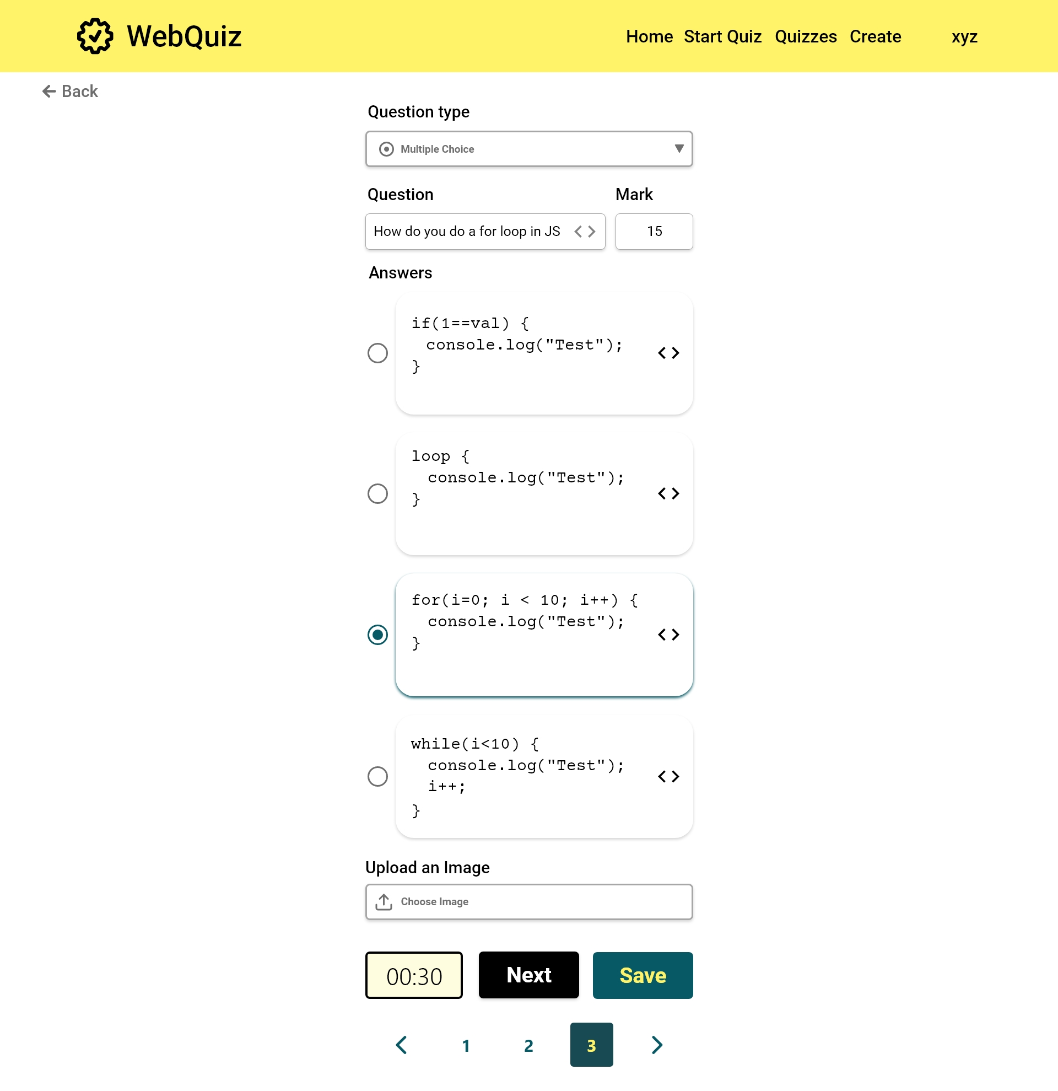

Slide 57


Slide 58


Slide 59
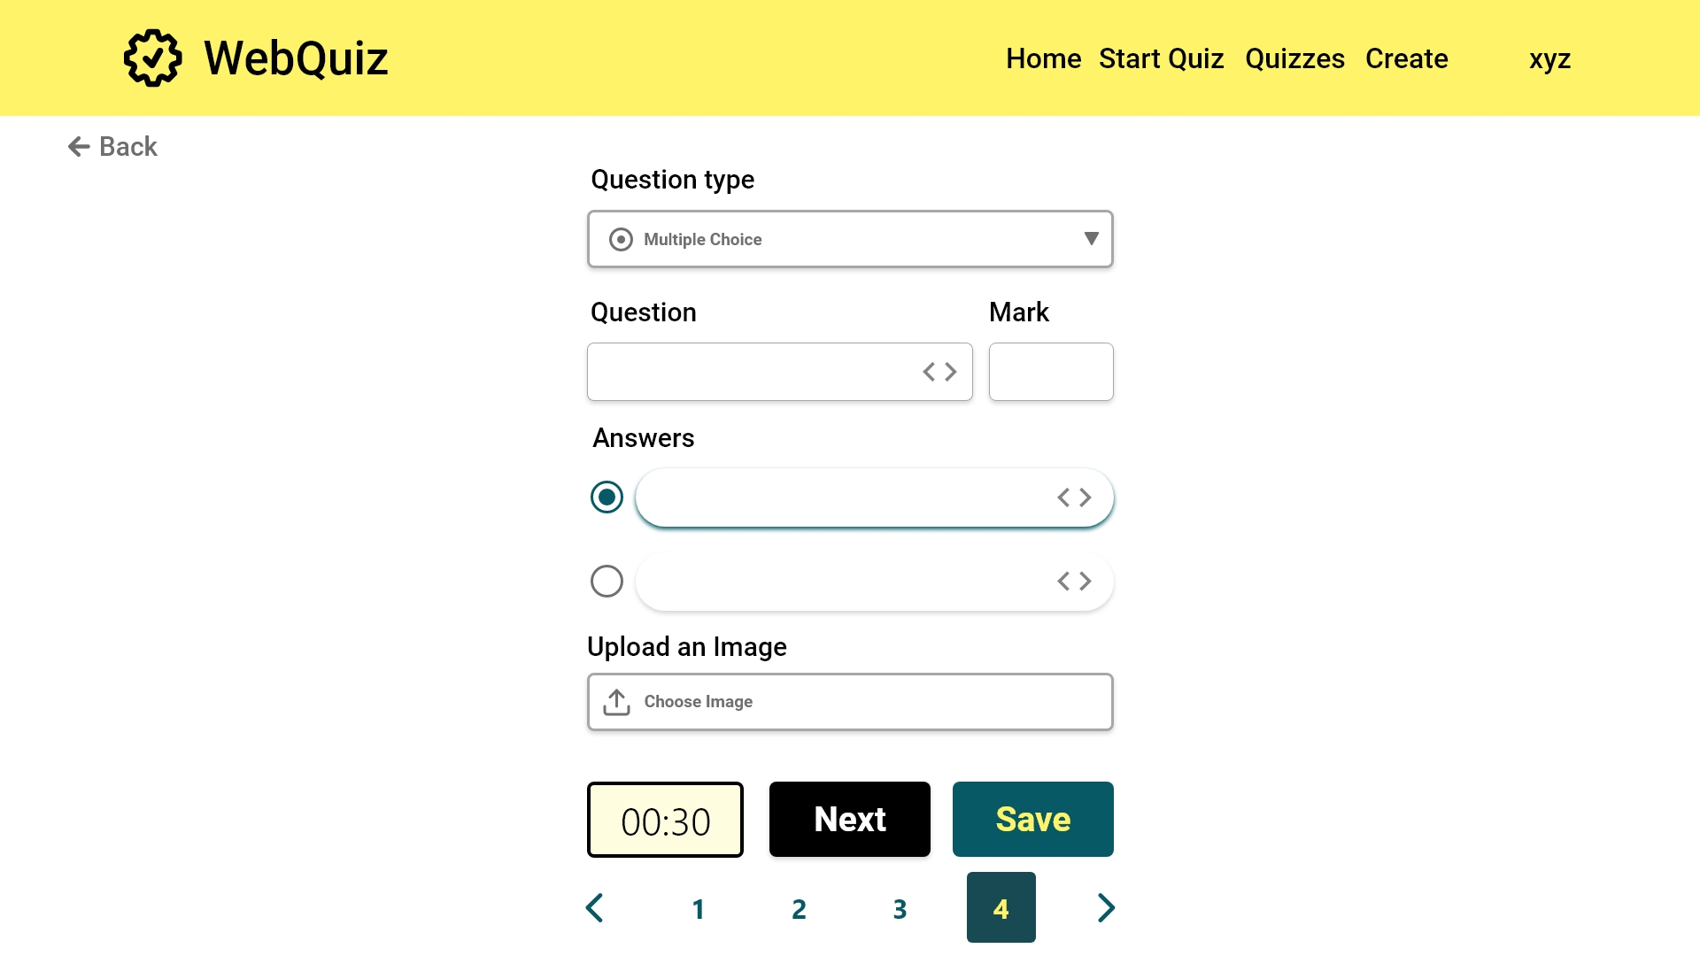

Slide 60
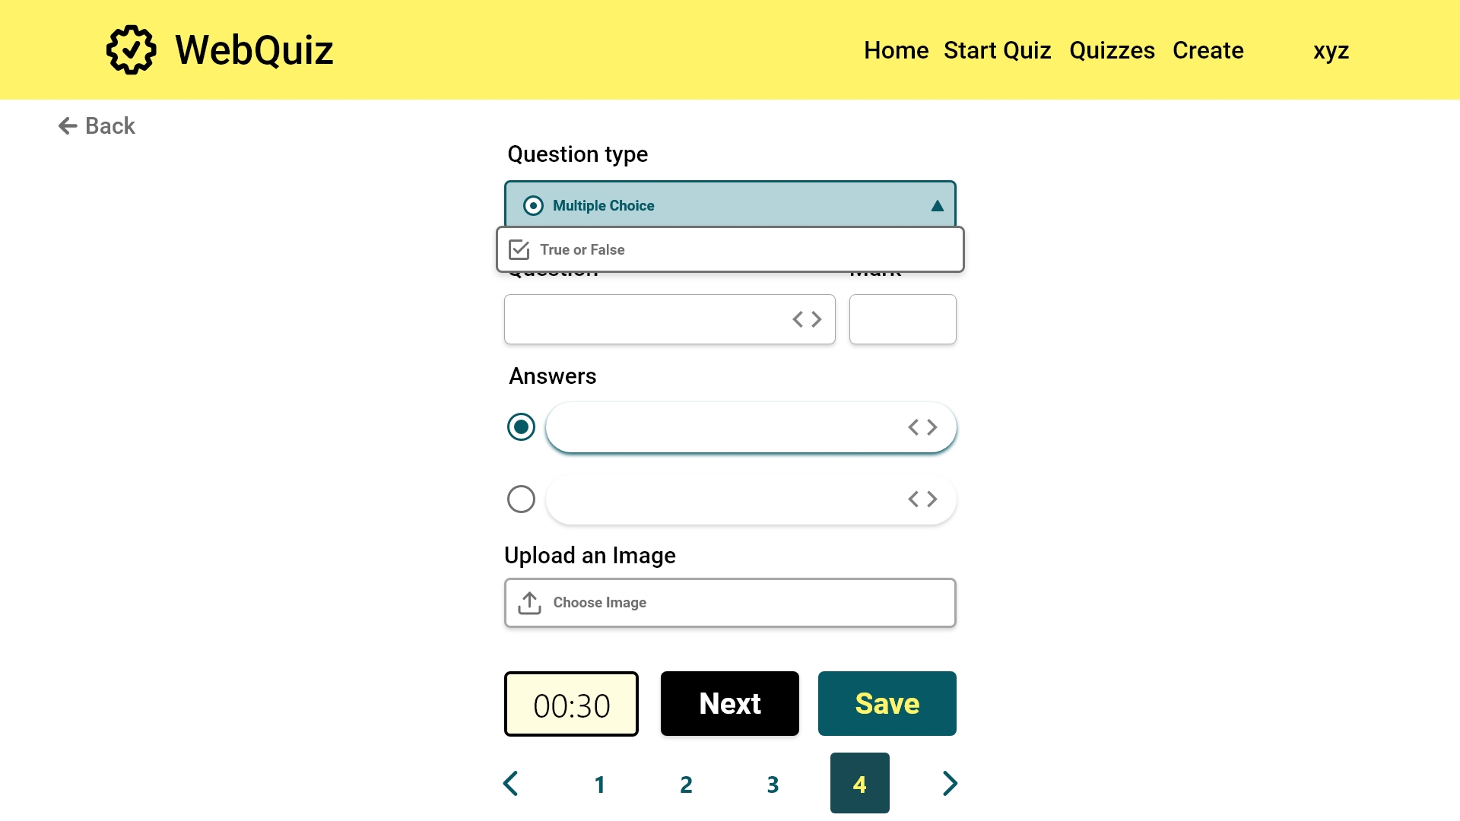

Slide 61
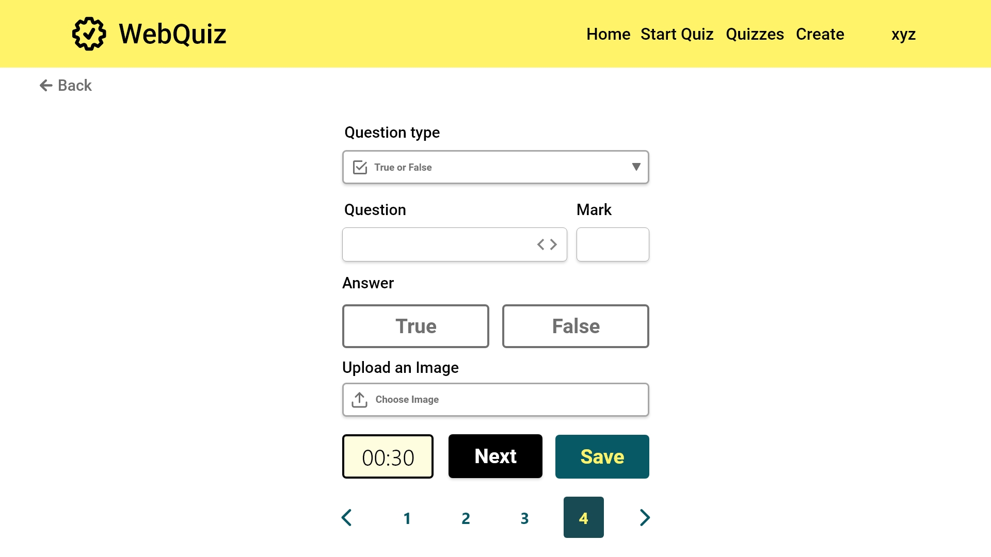

Slide 62
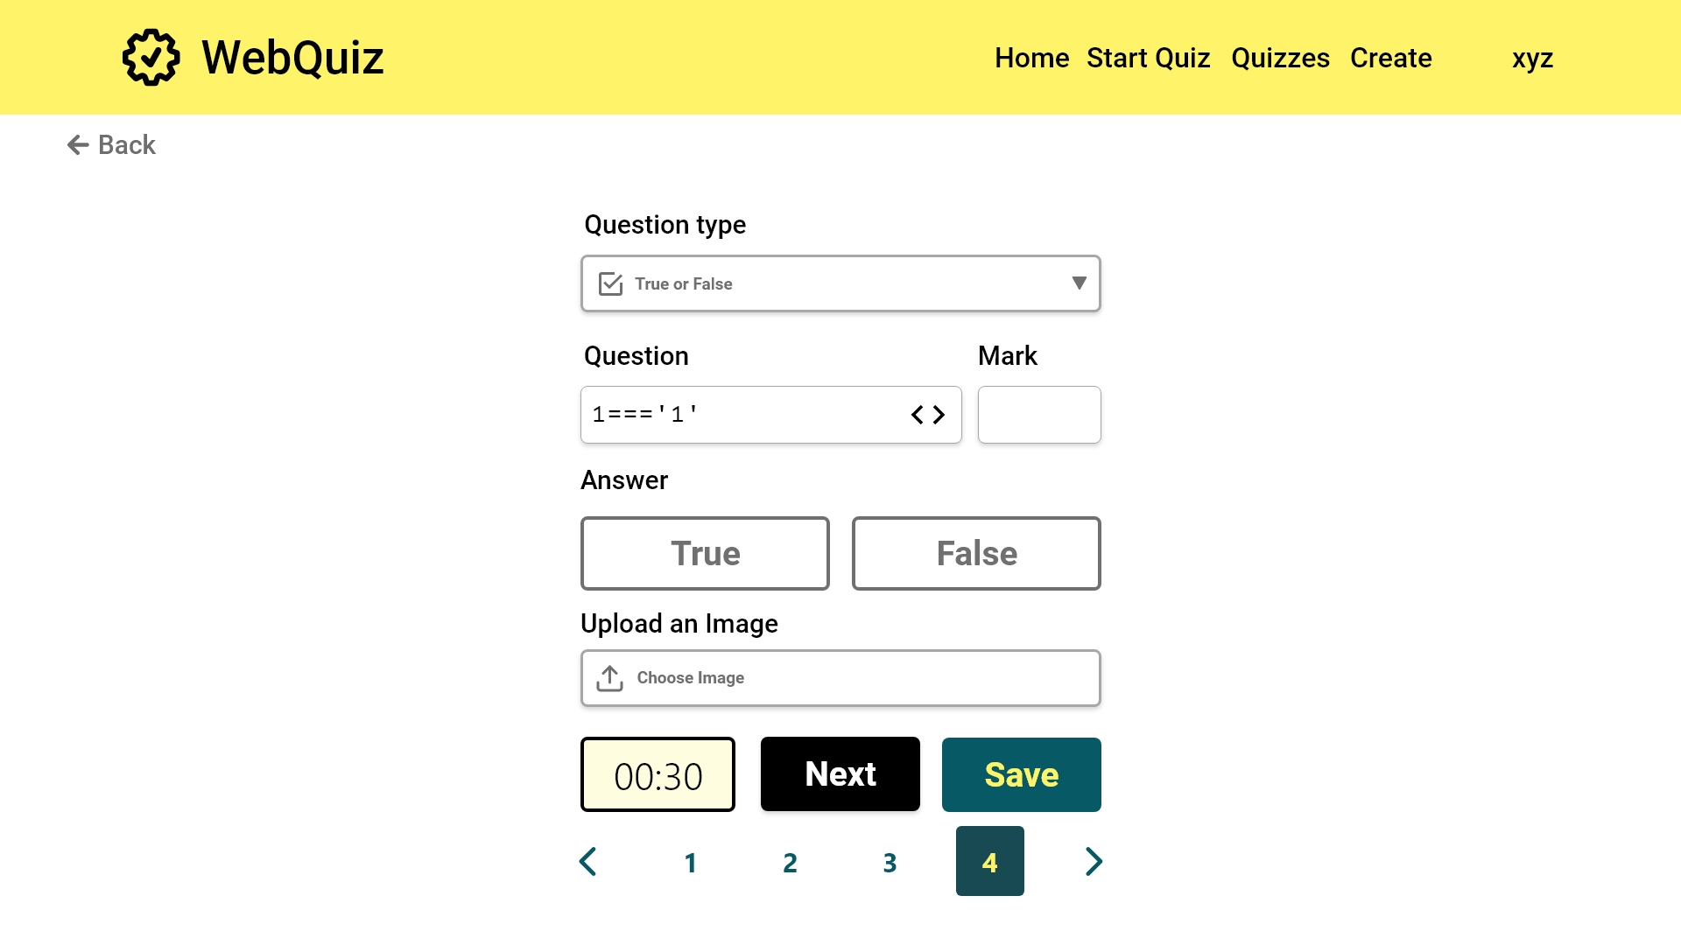

Slide 63


Slide 64
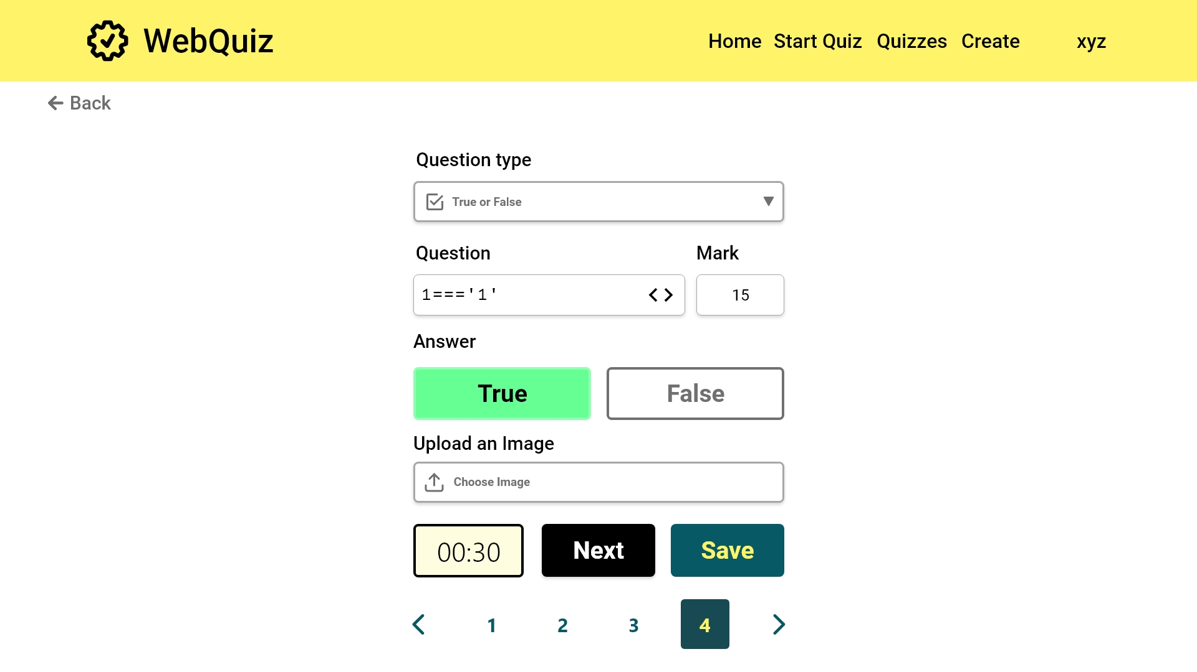

Slide 65
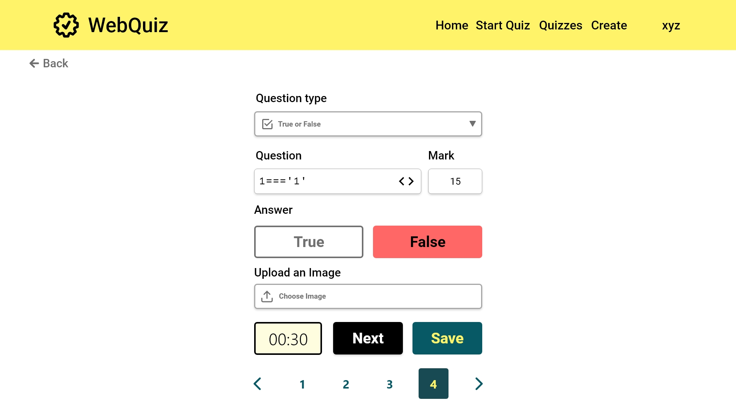

Slide 66


Slide 67
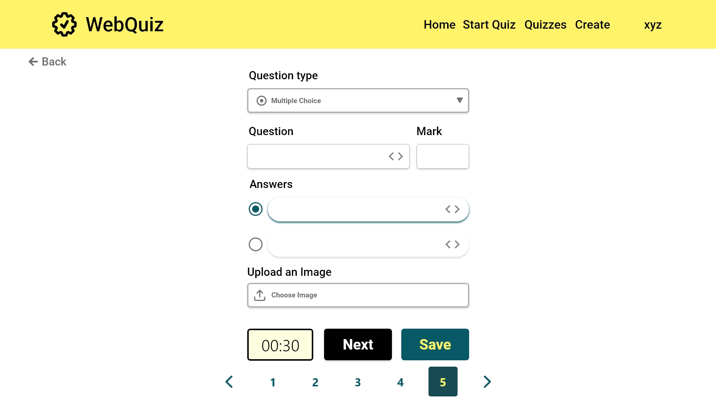
[FR7]: When the questions have been entered, this button will go to the preview screen

Slide 68
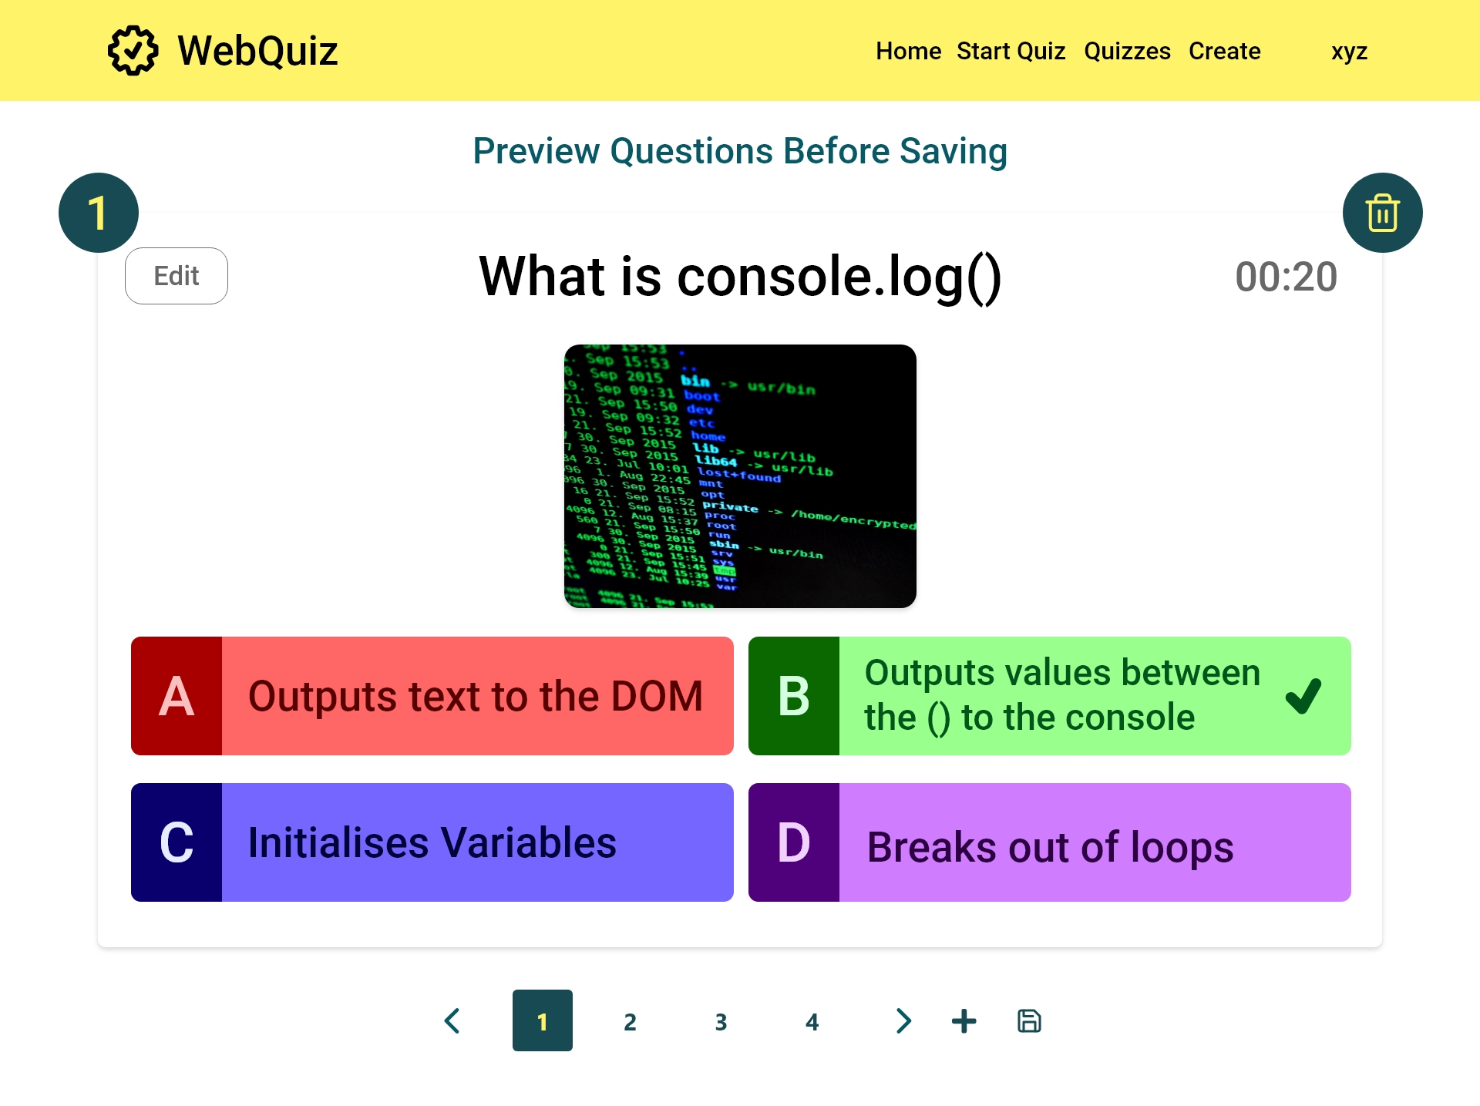
USE CASE 1.3
Quiz Maintainer preview quiz
[FR5]: A question can be deleted with this button
[FR6]: The quiz maintainer is able to edit a question here
[FR6]: The quiz maintainer can add more questions here
[FR7]: When the user is happy with the questions this button will save the quiz

Slide 69
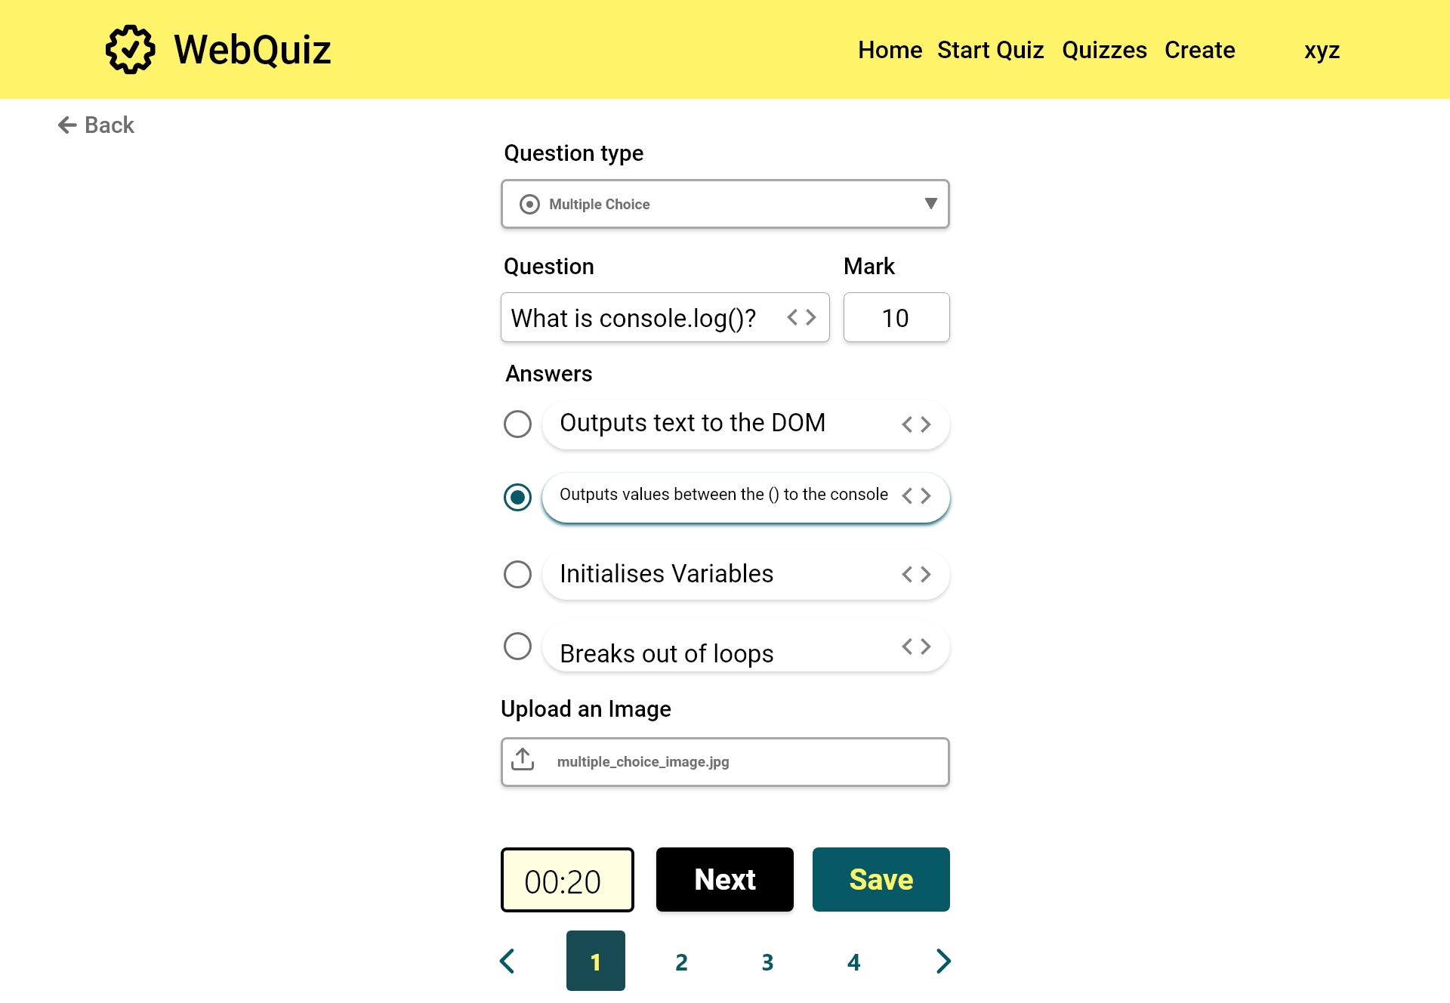
[FR6]: The quiz maintainer is able to edit a question here

Slide 70


Slide 71


Slide 72


Slide 73


Slide 74


Slide 75


Slide 76

[FR5]: Once the delete has been committed, it can be undone

Slide 77
Quizzes

Slide 78

[FR8]: The questions can be sorted alphabetically or by date
USE CASE 1.4
Quiz Maintainer view quizzes
[FR8]: All created quizzes are listed here. These can be edited or deleted as needed.
Edit quiz
USE CASE 1.5
Quiz Maintainer edit quiz
[FR19]: Quiz Maintainer can export quiz.
[FR9]: Quiz Maintainer can provide a link to Quiz Master to start a quiz.
USE CASE 1.6
Quiz Maintainer delete quiz
USE CASE 2.2
Quiz Master view quizzes
[FR20]: The user can import a previously created quiz here

Slide 79


Slide 80


Slide 81


Slide 82


Slide 83


Slide 84

[FR20]: The user can import a previously created quiz here

Slide 85


Slide 86

Delete Quiz

Slide 87
Start Quiz Menu

Slide 88

USE CASE 1.7
Quiz Maintainer start quiz
[FR13]: As a quiz master, this button can be used to start the quiz when ready
USE CASE 2.3
Quiz Master start quiz
[FR20]: A quiz can be imported as a quiz master also

Slide 89
Start Quiz

Slide 90

[FR12]: The quiz master can enable or disable the timer
[FR10]: A code is generated that quiz participants can use to join
[FR13]: When all participants have arrived the quiz master can start the quiz
USE CASE 2.3
Quiz Master start quiz
Change between
participant and Quiz Master

Slide 91

Change between
participant and Quiz Master

Slide 92

[FR17]: The quiz participant can use the link and code to join the session
USE CASE 3.0
Quiz Participant join quiz
Change between
participant and Quiz Master

Slide 93
Question 1

Slide 94

USE CASE 2.3
Quiz Master start quiz
[FR11]: Viewing a shared screen that shows question and possible answers.
[FR14]:Quiz master can manually step through the questions
Change between
participant and Quiz Master

Slide 95

Change between
participant and Quiz Master

Slide 96
Participant view Question 1

Slide 97

[FR17]: A running multiple choice quiz as it appears to a participant
USE CASE 3.1
Quiz Master taking quiz
[FR18]: A participant can choose to separate the questions and answers
Switch to mobile view
Change between
participant and Quiz Master

Slide 98

EIR2 Responsive web design
Switch to desktop view

Slide 99

Switch to desktop view

Slide 100

Change between
participant and Quiz Master

Slide 101

Change between
participant and Quiz Master

Slide 102

Change between
participant and Quiz Master

Slide 103
Question 2

Slide 104

[FR17]: A running true or false quiz as it appears to the quiz master
[FR14]: The quiz master can step through the quiz as needed
[FR15]: A running quiz can be stopped if necessary
Change between
participant and Quiz Master

Slide 105

Change between
participant and Quiz Master

Slide 106
Participant view Question 2

Slide 107

[FR17]: A running true or false quiz as it appears to a participant
Switch to mobile view
Change between
participant and Quiz Master

Slide 108

Switch to desktop view

Slide 109

Switch to desktop view

Slide 110

Change between
participant and Quiz Master

Slide 111

Change between
participant and Quiz Master

Slide 112

Change between
participant and Quiz Master

Slide 113
Question 3

Slide 114

Change between
participant and Quiz Master

Slide 115

Change between
participant and Quiz Master

Slide 116
Participant view Question 3

Slide 117

Change between
participant and Quiz Master

Slide 118

Change between
participant and Quiz Master

Slide 119

Change between
participant and Quiz Master

Slide 120
Change between
participant and Quiz Master

Slide 121
Question 4

Slide 122

Change between
participant and Quiz Master

Slide 123

Change between
participant and Quiz Master

Slide 124
Participant view Question 4

Slide 125

Change between
participant and Quiz Master

Slide 126

Change between
participant and Quiz Master

Slide 127

Change between
participant and Quiz Master

Slide 128

Change between
participant and Quiz Master

Slide 129
Results

Slide 130

[FR16]: At the end of the quiz an individual score will be given

Slide 131


Slide 132


